Slide 1
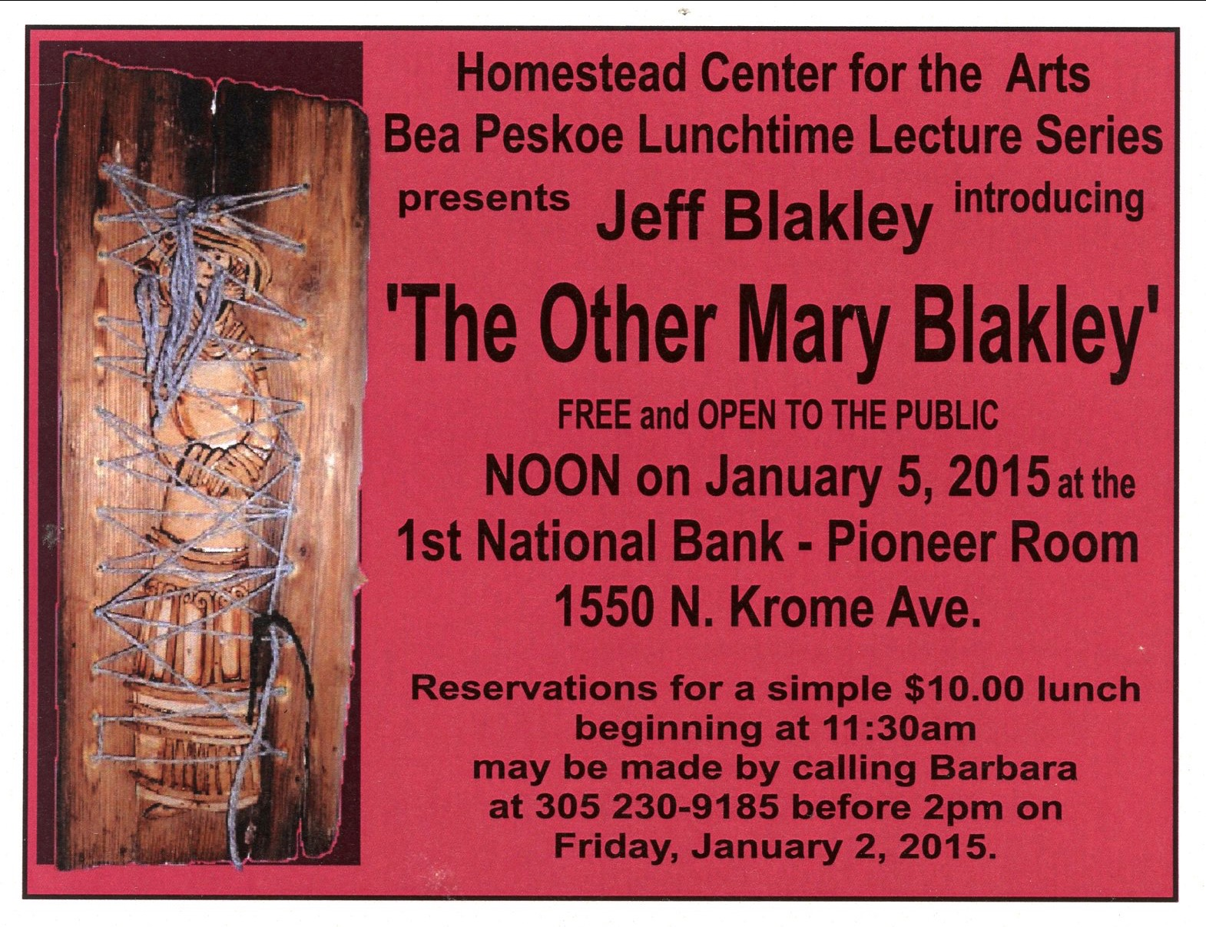

Slide 2
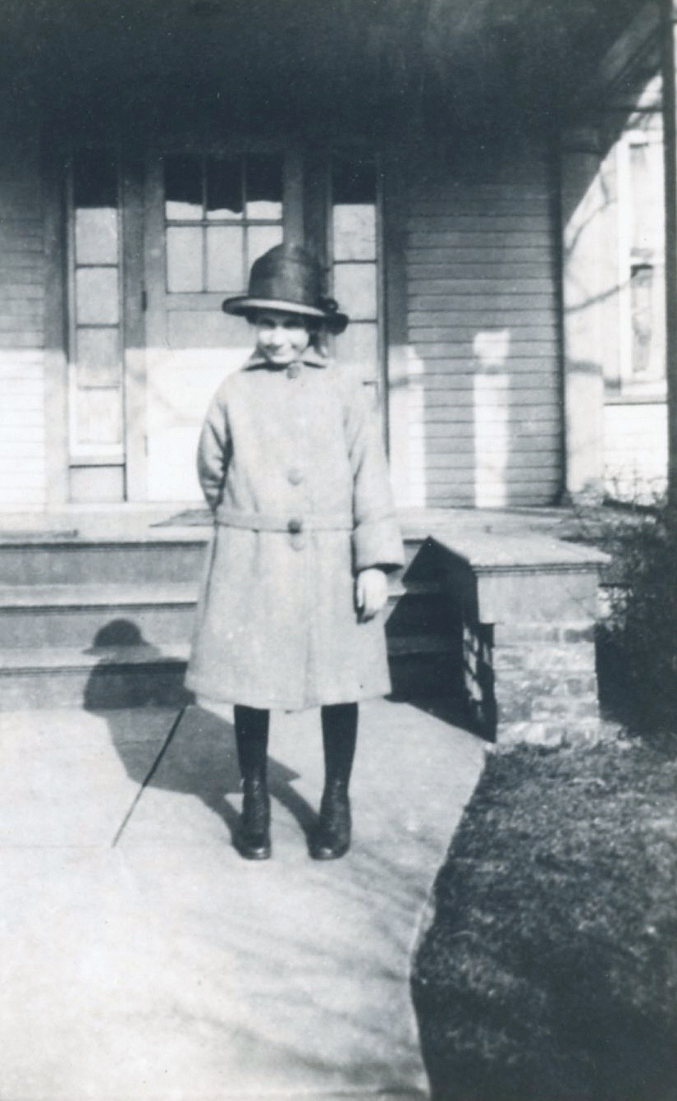
Notes:
Mary was born on January 30, 1914, at her parents home in Fort Wayne, Indiana. Here she is, at about age 10, standing in front of the house she grew up in on Ardmore Avenue.

Slide 3
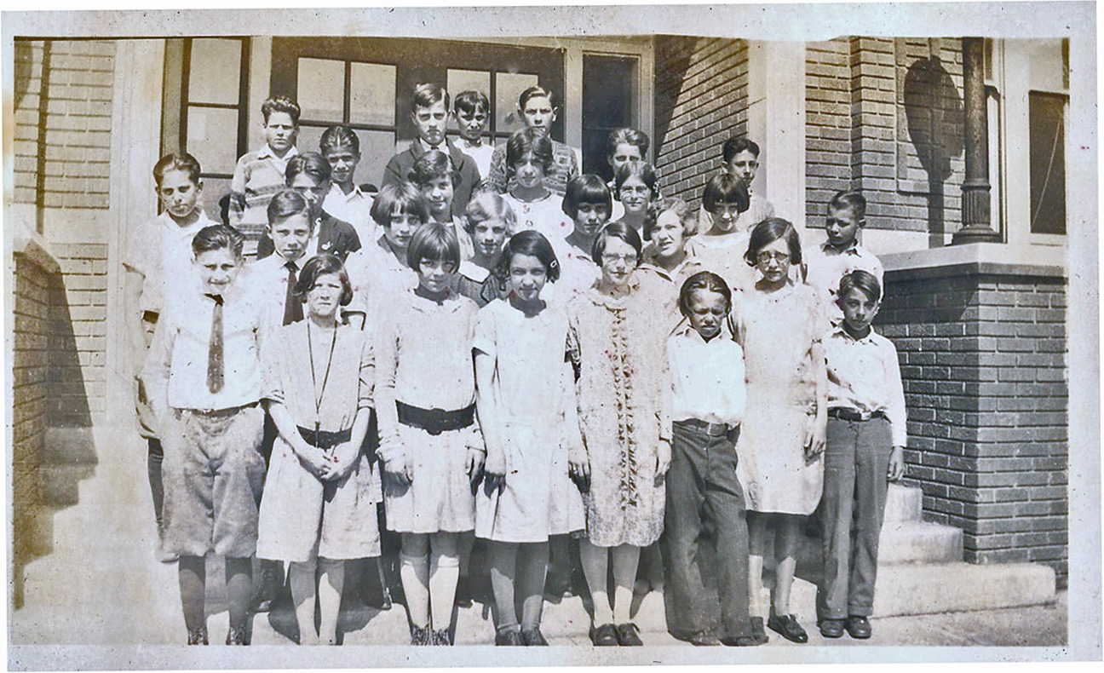
Notes:
Mary’s mother was a school teacher who, after marrying, became a social activist and a homemaker. Her father, Charles, was also a school teacher and later became the principal of Harrison Hill school in Fort Wayne, which is now a middle school. In this picture, taken at Harrison Hill, Mary is standing in the middle of the front row in the dress without a belt.

Slide 4
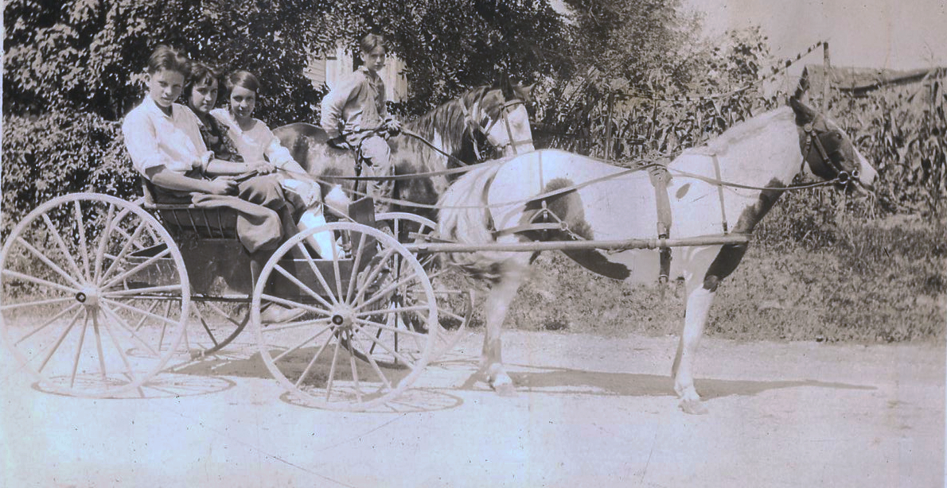
Notes:
Mary’s father, Charles, was from Sardinia, in Decatur County in southeast Indiana. He took his family down to the farm to visit his cousin, Harry, from time to time. Here is Mary, in a horse-drawn wagon, with her brother, John, holding the reins in front and her second cousin, Mildred, in the middle.

Slide 5
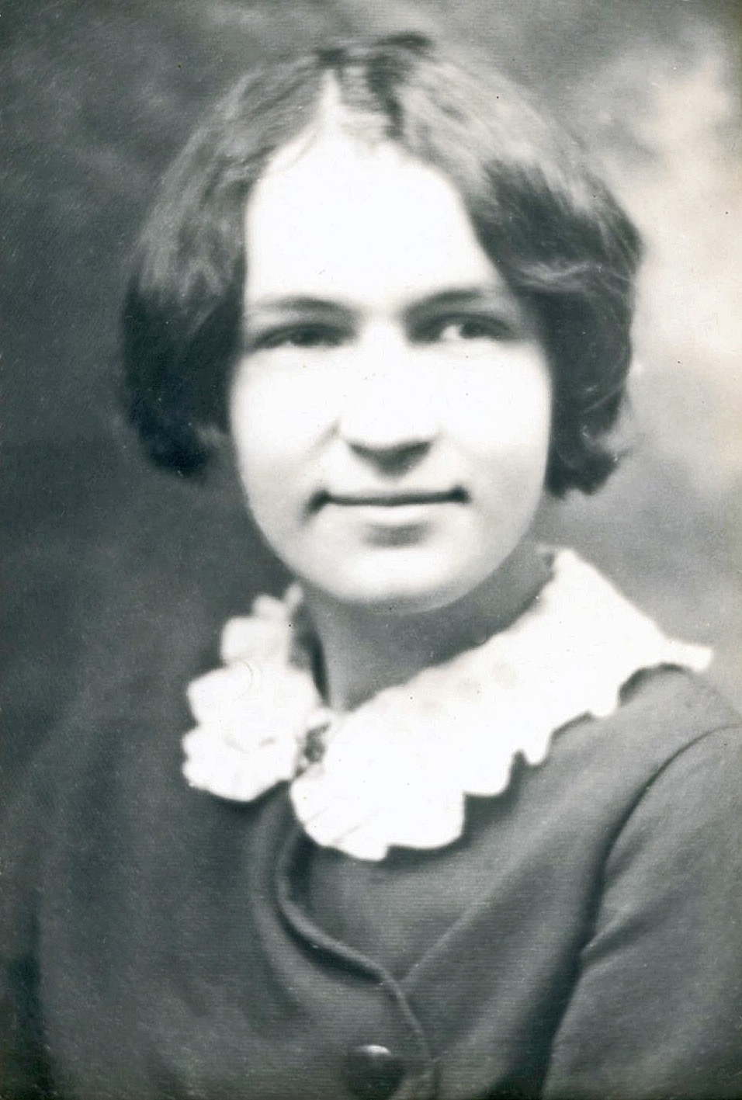
Notes:
This is Mary, at the age of 16.

Slide 6
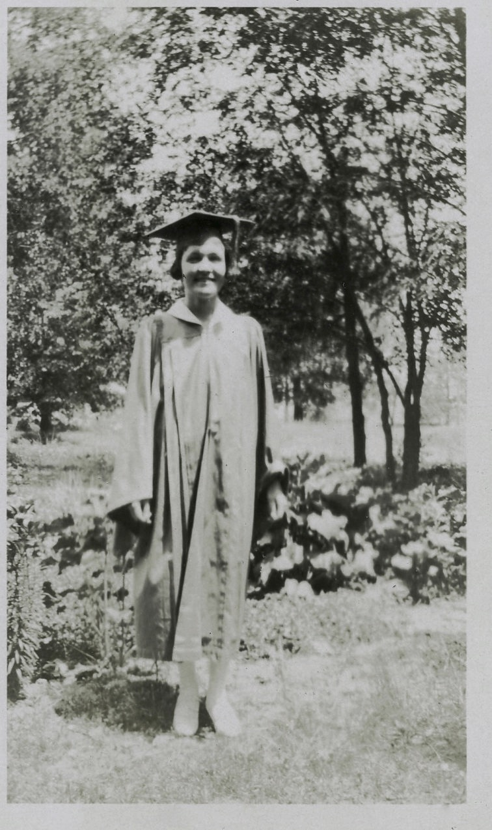
Notes:
Mary graduated from South Side High School in Fort Wayne in 1930, at the age of 16 1/2. She delighted in telling the story of how she skipped a grade while her husband got mostly “D”s and “F”s in school, except in Art, in which he always got “A”s.

Slide 7
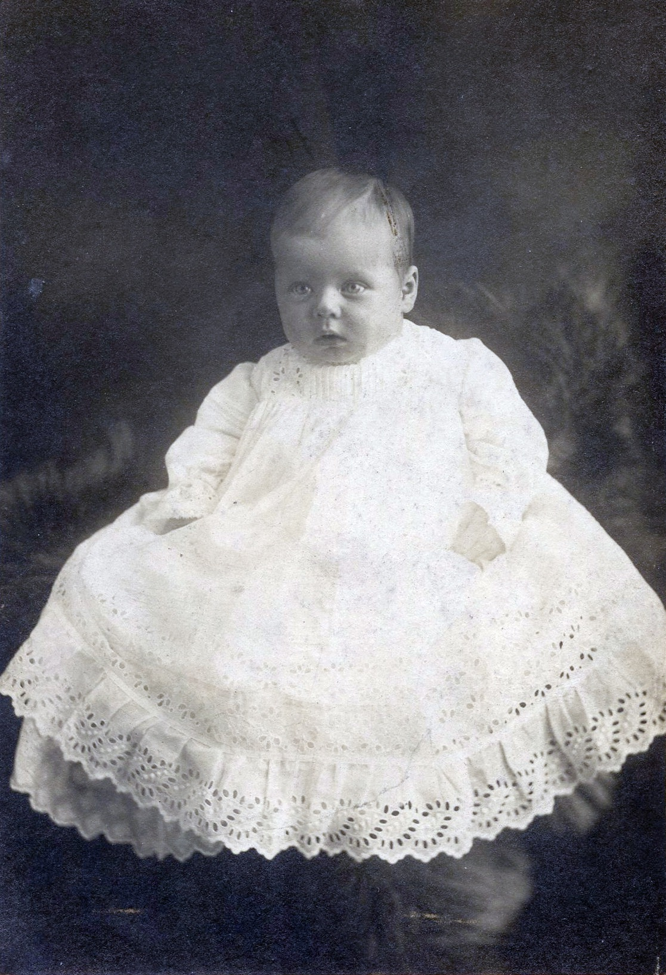
Notes:
Tom Blakley was born on July 1, 1910 in Guthrie, Oklahoma, where his father was working at the time with his brother, Fred, in the road-construction business. This is a picture of Tom when he was 3 months old. It was taken in Montreal, Canada. Tom was born in Guthrie, Oklahoma, but his father traveled a lot, going wherever he could find work.

Slide 8
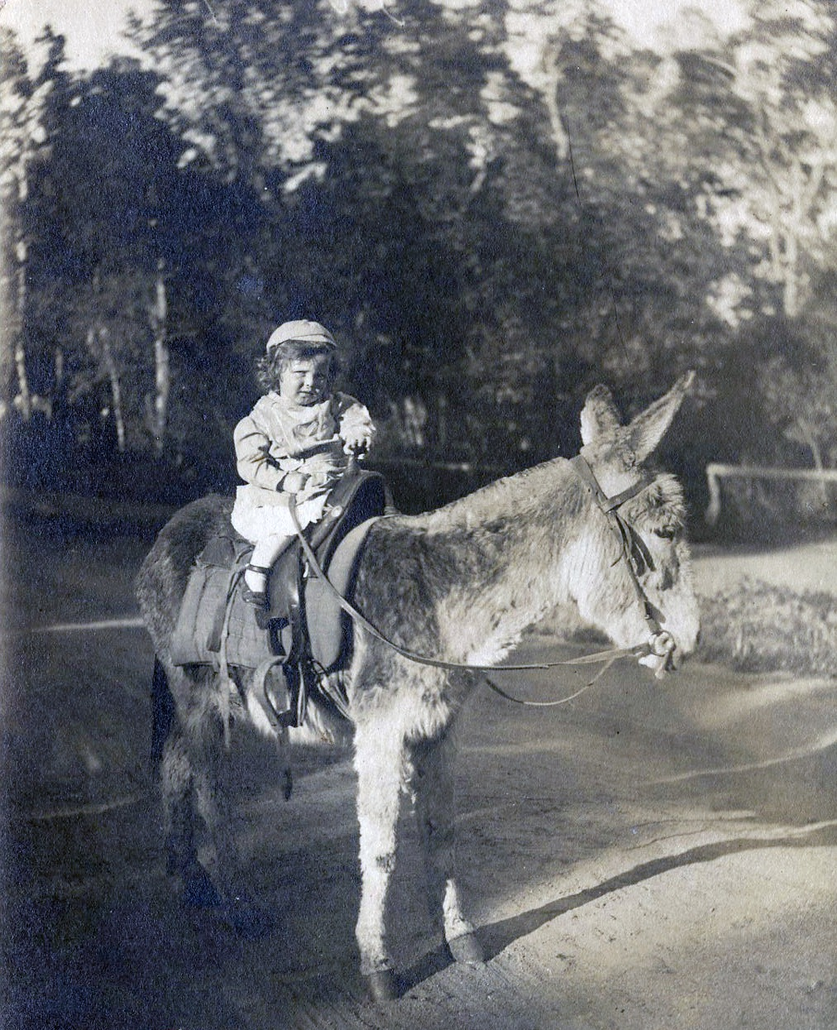
Notes:
This is Tom at the age of 3 1/2 - his father was in Colorado Springs, Colorado at this time. This was taken in Stratton Park in early 1914.

Slide 9
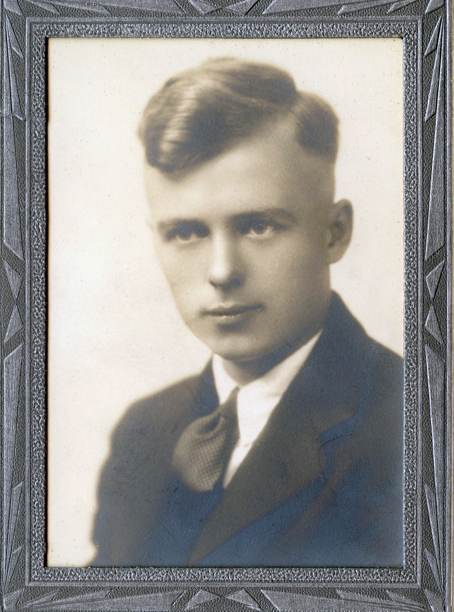
Notes:
By about 1916, Tom’s father had settled in Fort Wayne, though Tom lived in 3 different houses before living in the house he grew up in, at 162 State Street, 1n 1922. He graduated from North Side High School, South Side’s cross-town rival, on June 13, 1930. He wasn’t the best student, apparently, since he graduated at the age of 20, but he always got A’s in his art classes. This is his high school graduation photograph.

Slide 10
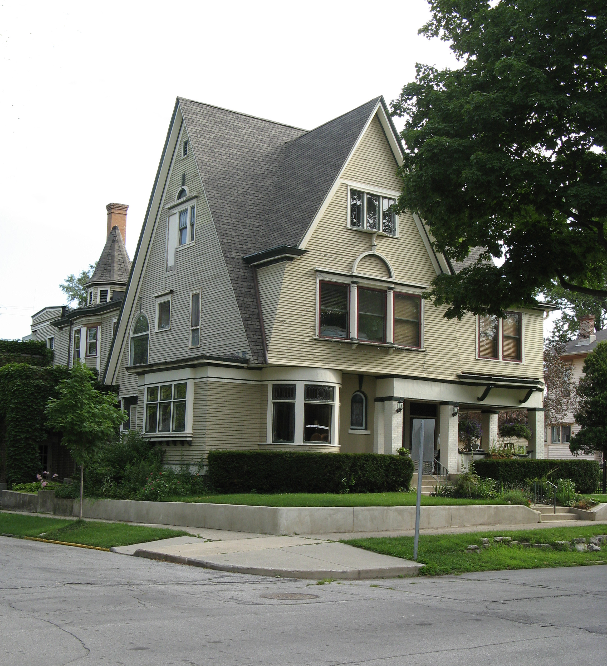
Notes:
This is where Tom and Mary met - at the Fort Wayne Art School. The school was a commercial and fine arts school and was located in this house, at 1026 W. Berry St., until it was taken over by Indiana/Purdue University in the mid-1970s. Tom and Mary attended the school for two years, spread over more time than that, for times were hard in those days and neither of them had the financial support of their parents. Later, Tom and Mary spent time in New York City, where Tom worked for the Works Project Administration, assembling dolls in a factory. The two of them witnessed the installation of Diego Rivera’s mural, which was subsequently destroyed by the owner of the building, John D. Rockefeller. They rode the subways and frequented Harlem, where Mary, years later, marveled that she had seen Ella Fitzgerald, well before she became a nationally known artist. Tom also attended classes at the Art Students League, where he studied under George Grosz, a well-known German satirical cartoonist.

Slide 11
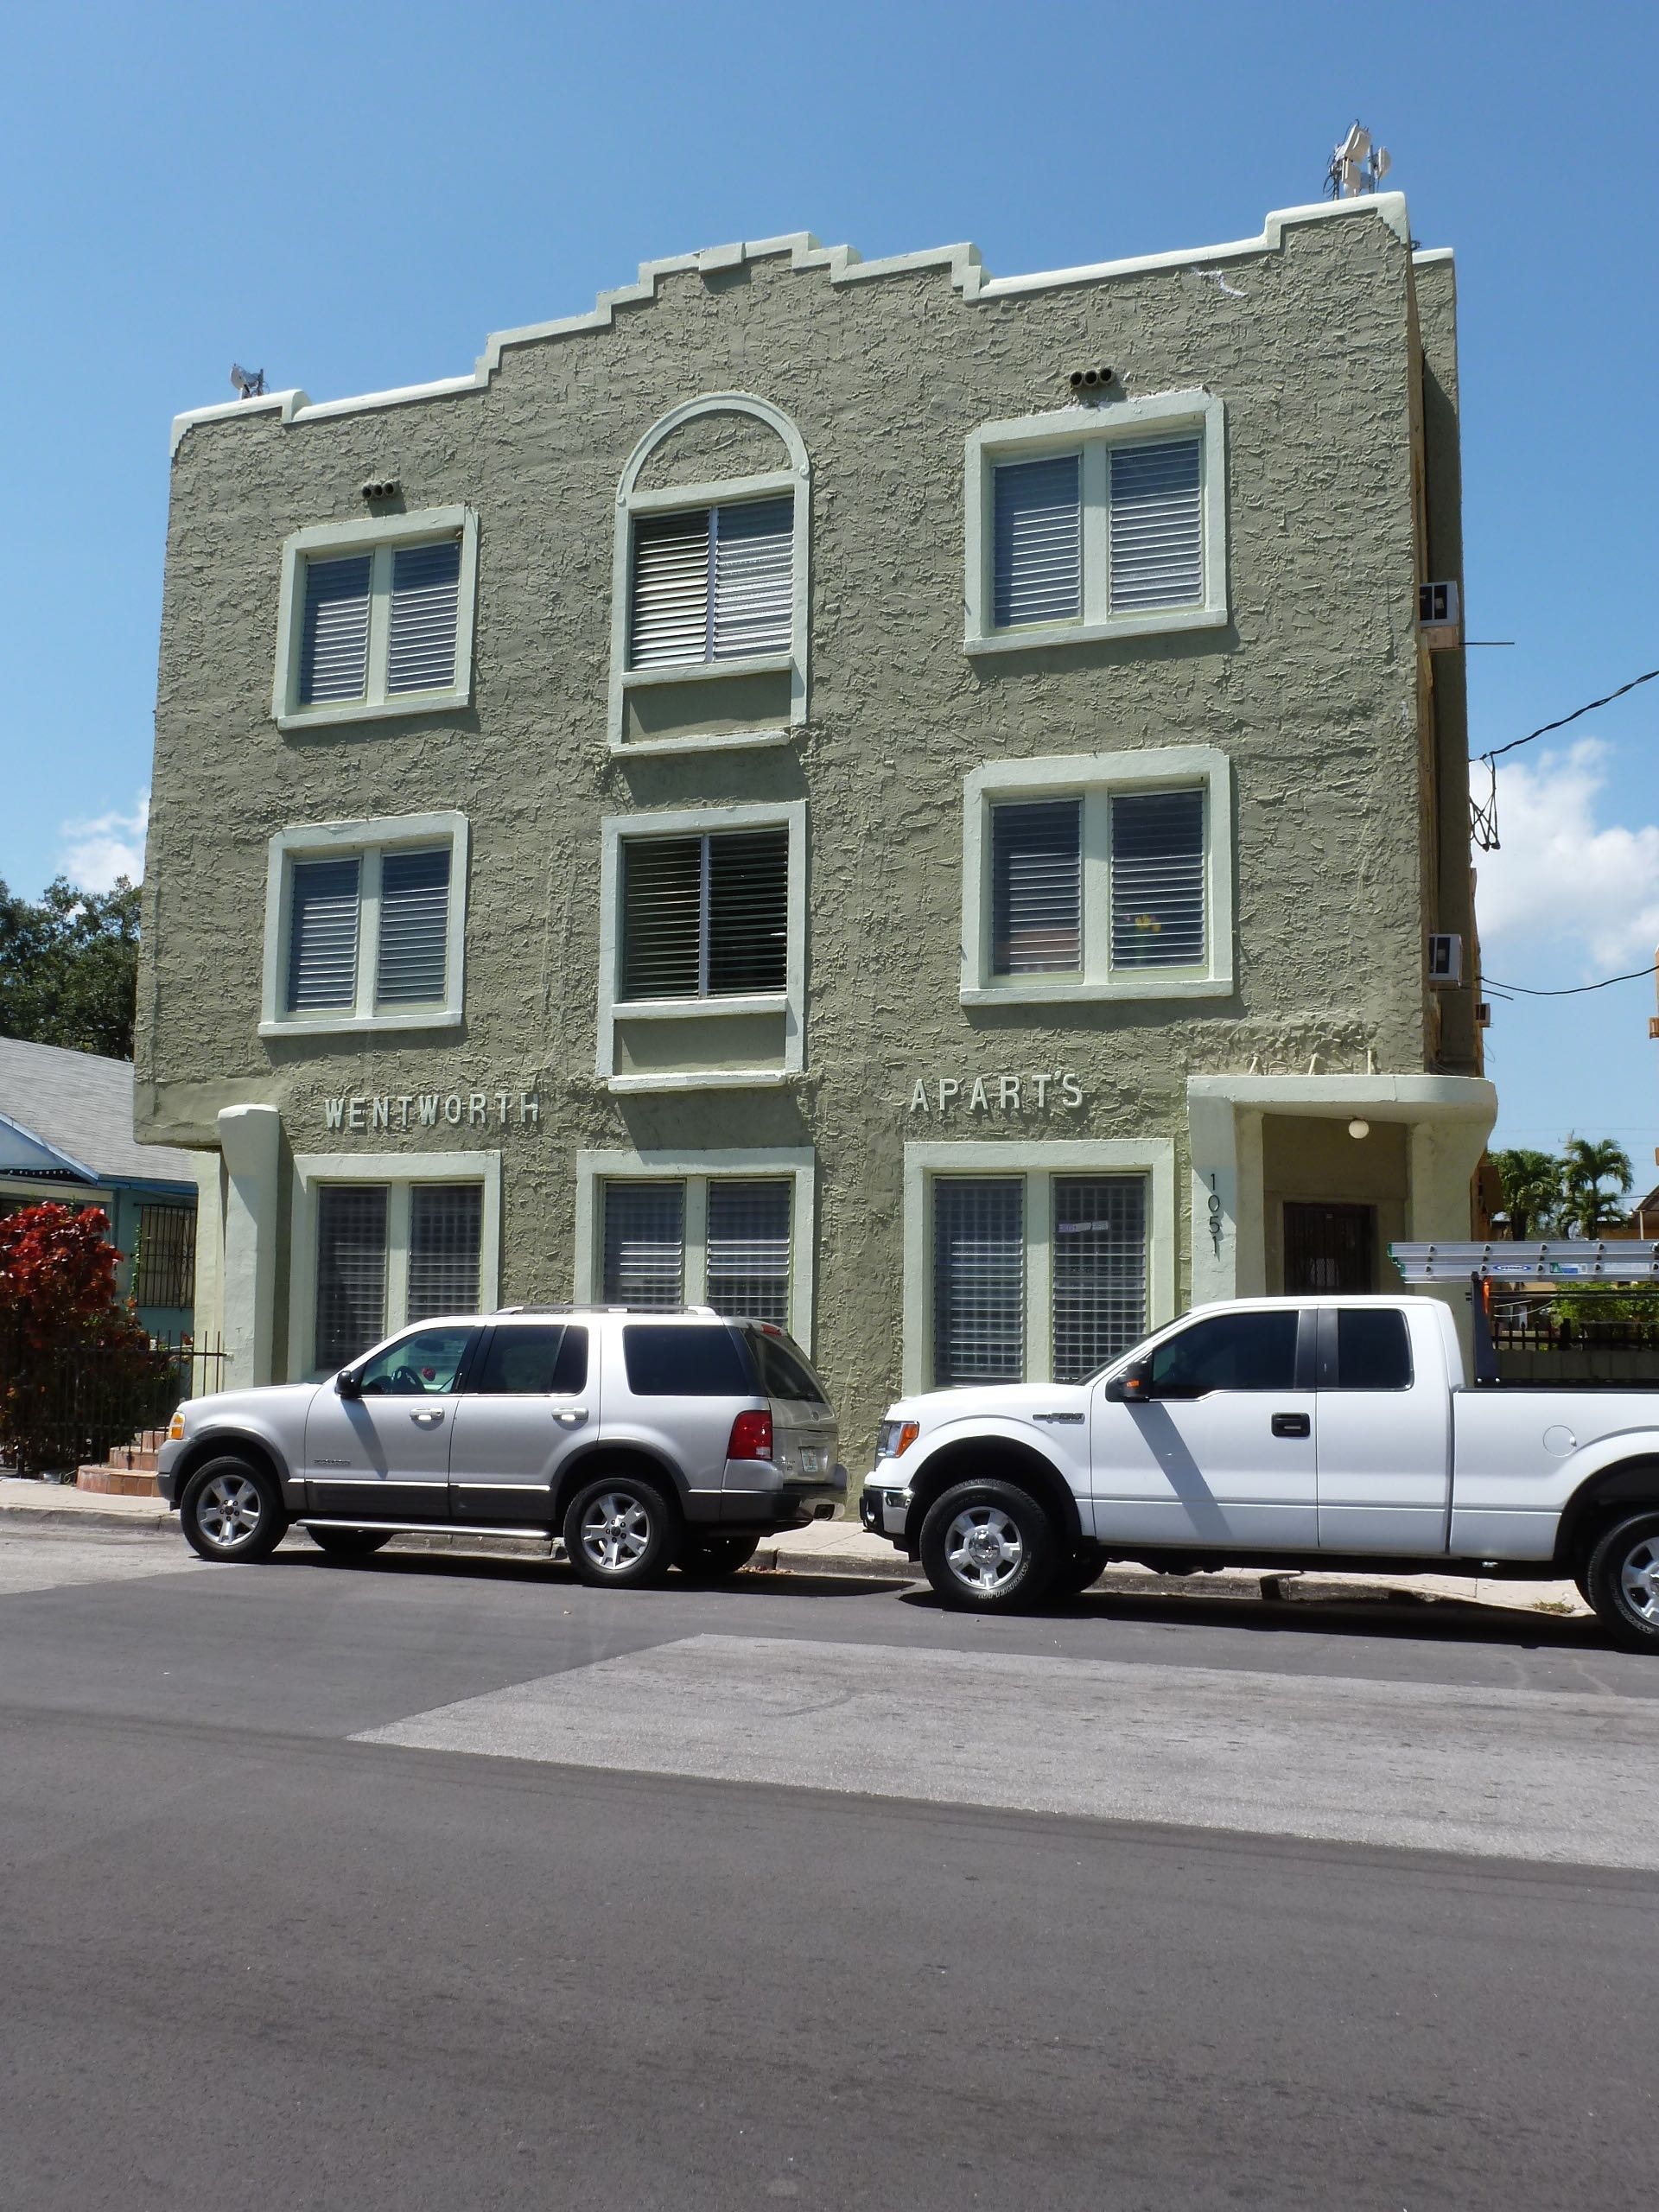
Notes:
Tom and Mary were married in Fort Wayne on July 13, 1936. On December 30, 1937, they set out on a road trip to Florida, towing a home-made trailer and stopping in Bay St. Louis, Mississippi for 6 weeks, where they took in the sights, drew and painted. They went as far south as Tampa and on their return trip, stayed in Cedar Keys for about 6 months. When they returned to Fort Wayne, Tom worked at his craft diligently, while supporting himself in various odd-jobs. Remember, this was the Depression and work was hard to come by. Mary worked as a window display designer for Woolworth’s in 1938 and as a cake decorator for Bon Ton bakery in 1939. Tom’s first sale as a cartoonist (5 cartoons for $5.00) was to the magazine MiniCam sometime in 1938 - he was so excited that he “bounced down the aisle in Woolworth’s” according to what Mary told me one time. Mary’s father died on July 9, 1938 and her mother moved to Miami in early 1939, to be close to her son, Paul, who worked for Pan American World Airways at Dinner Key. She lived in this building, at 1051 N.W. 2nd St., in apartment 2. Mary visited her mother at Christmas time in 1940 and when she went back to Fort Wayne, told Tom that they ought to move to Miami, since Tom suffered terribly from pleurisy and bronchitis. In January, 1941, they moved into the same building, in apartment 4. I took this picture of the building this past summer. Amazingly enough for Miami, it still exists!

Slide 12
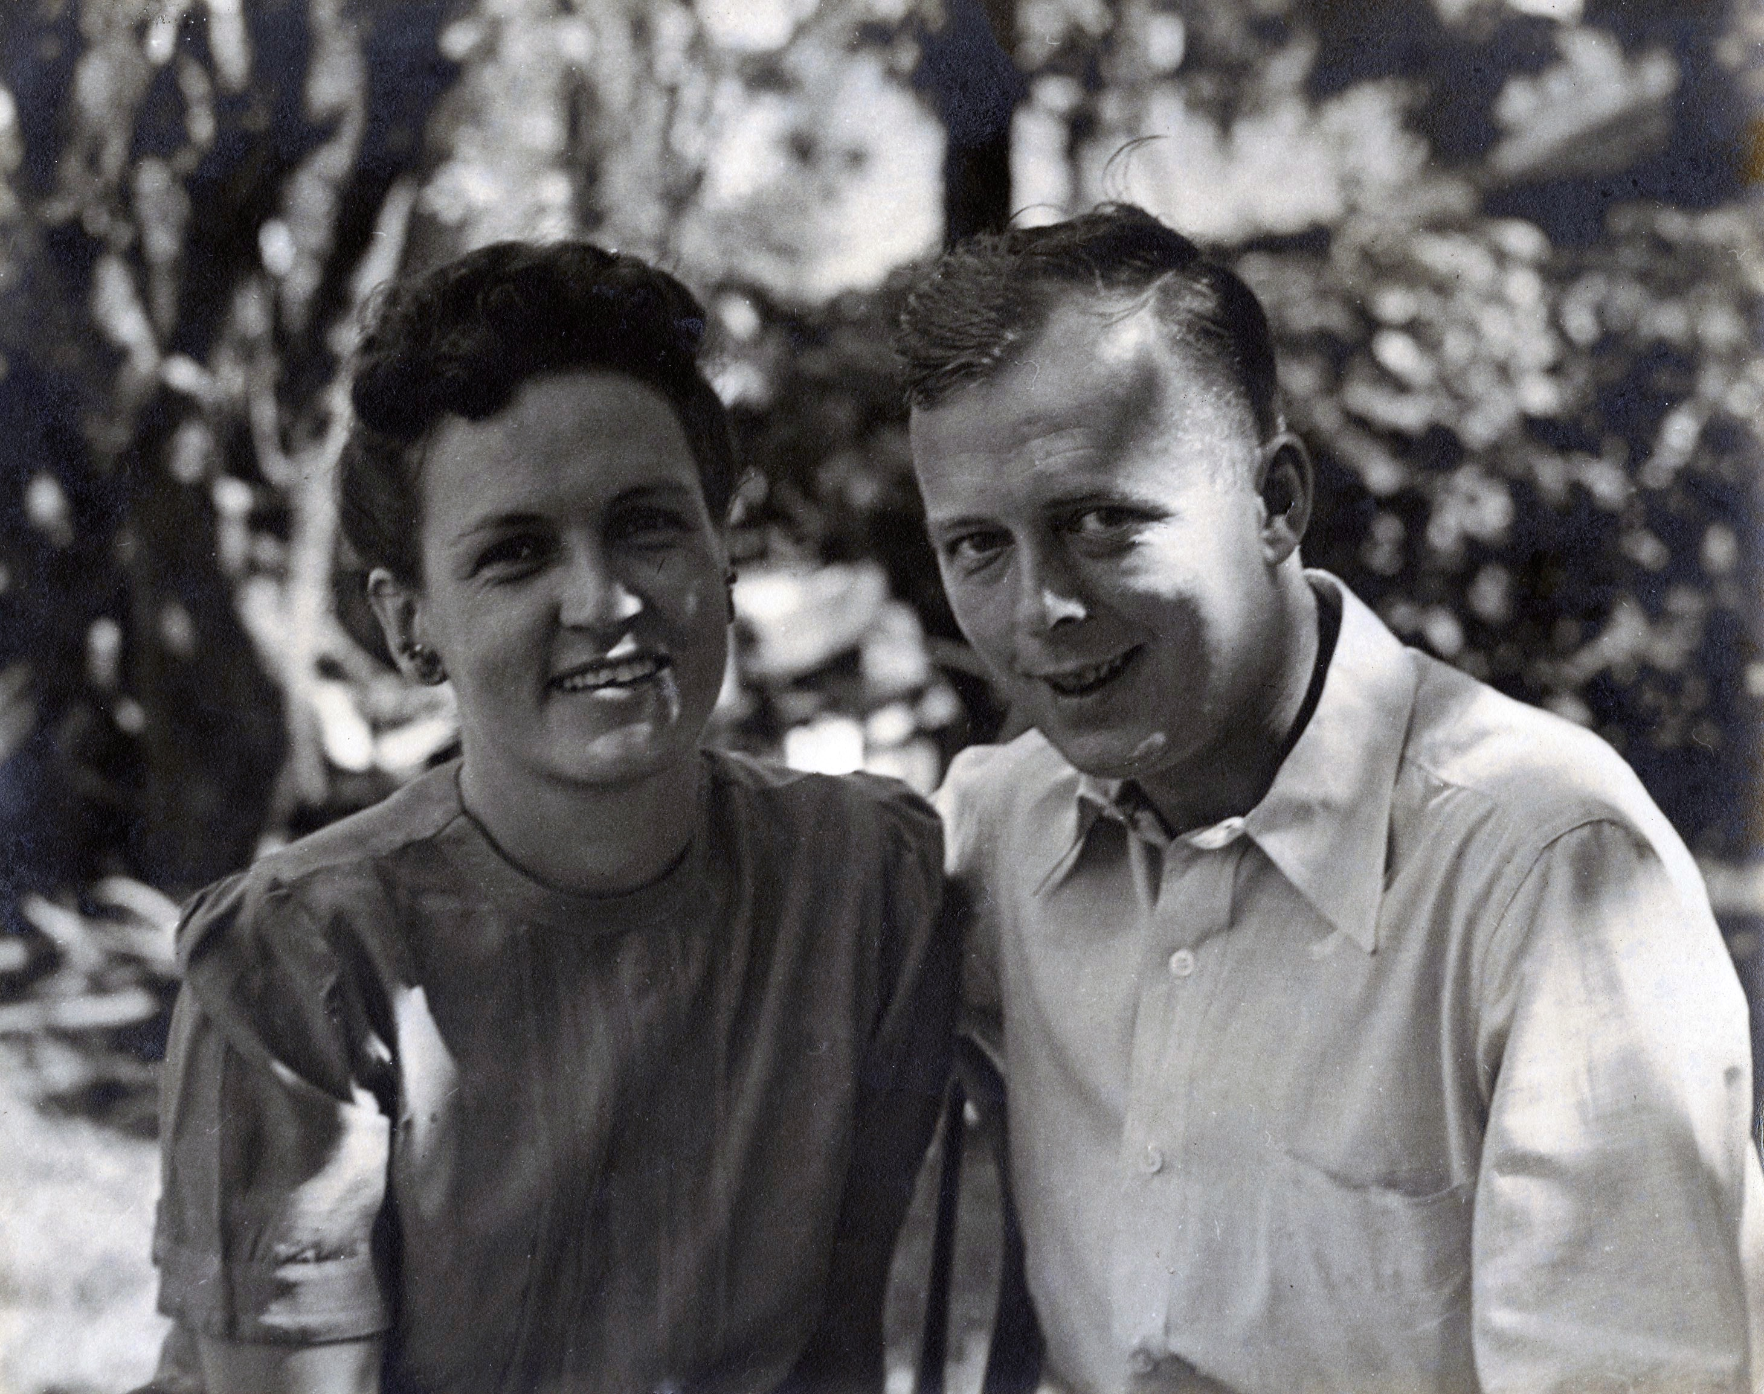
Notes:
In August of 1941, Mary’s mother, together with Mary’s aunt (her mother’s sister), bought a small house at 835 S.W. 12th Ct. in Miami. Tom and Mary Blakley moved from their apartment on N.W. 2nd St. to a garage apartment in back of the house. This photograph of the two of them was taken in September, 1945, after the bad hurricane of that year, by Mary’s brother, John, who was a professional photographer who had a studio in Fort Wayne. He had come down to see the damage. Hurricane tourism wasn’t invented after hurricane Andrew!

Slide 13
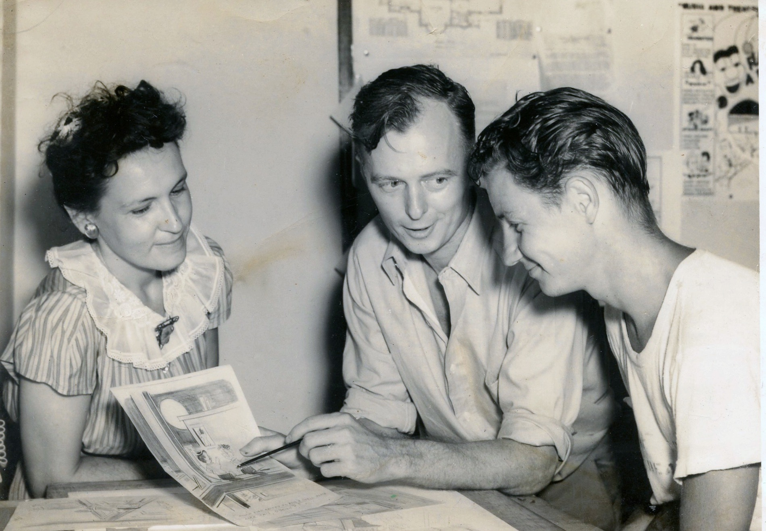
Notes:
Tom was not eligible for military service in World War II due to having flat feet and a history of respiratory ailments. To serve their country, he and Mary volunteered at the Red Cross Arts and Skills Corps hospital in Miami Beach where they taught servicemen recuperating from war injuries the craft of cartooning. The Arts and Skills Corps had 6,645 volunteers in 105 hospitals nation-wide in 1945-1946, according to a Red Cross website that I consulted. Here, they are showing T/Sgt. Charles H. Rogers the finer points of cartooning. He was a patient at the Army Air Force Regional and Convalescent Hospital on Miami Beach.

Slide 14
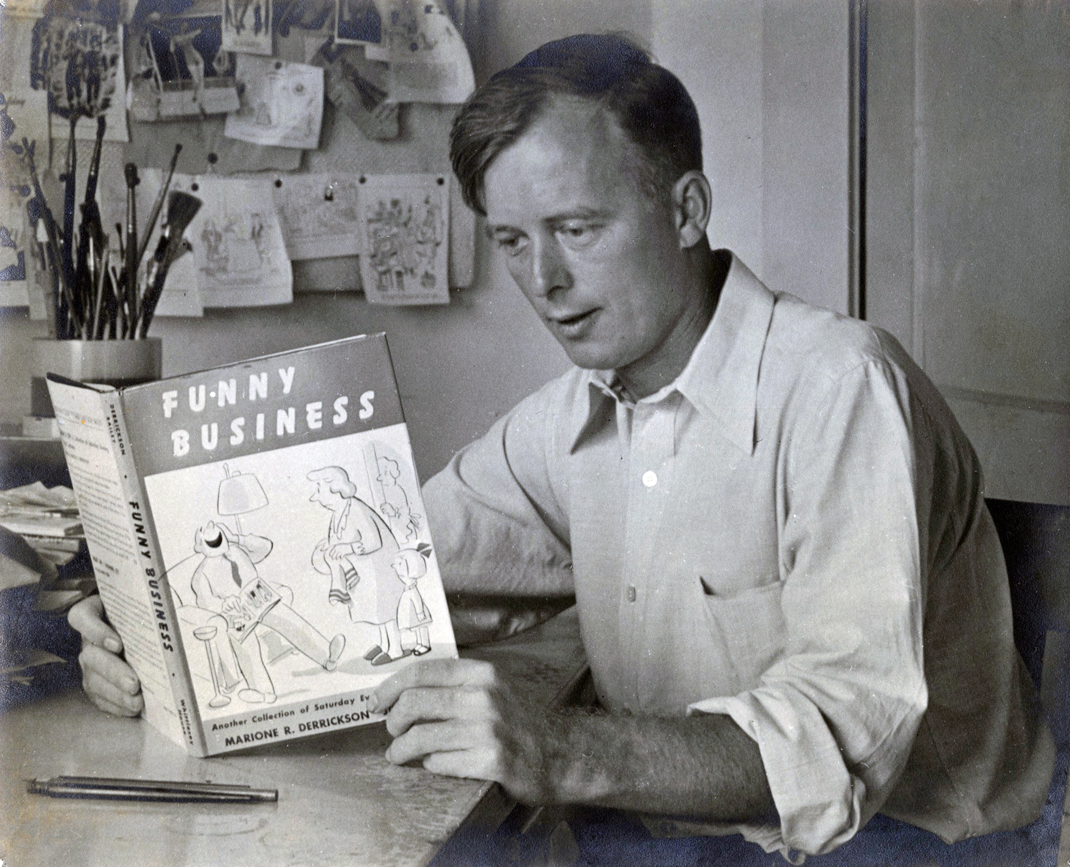
Notes:
Tom diligently perfected his cartooning skills in the early 1940s, while living in the apartment in back of his mother-in-law’s house in Miami. His cartoons appeared in the Saturday Evening Post, Colliers, American magazine and many trade journals. Four of his cartoons appeared in this book, a “best-of” collection of cartoons that had appeared in the Saturday Evening Post.

Slide 15
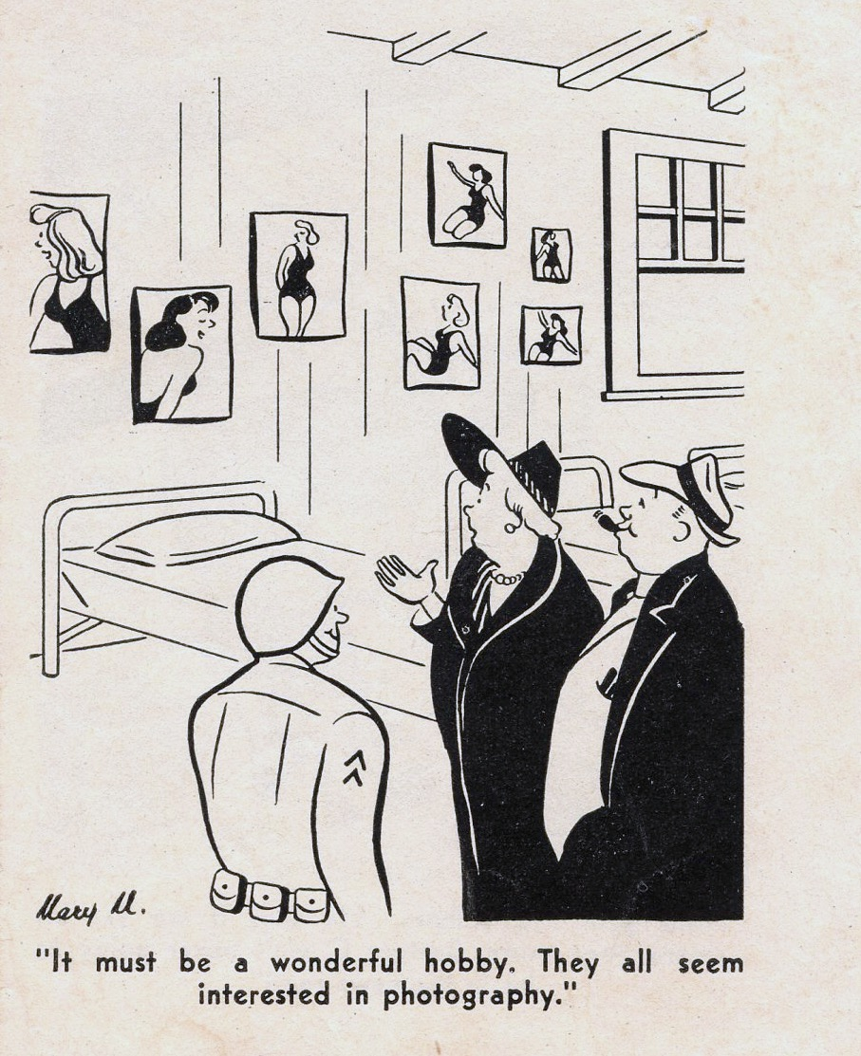
Notes:
This cartoon appeared in the magazine Mini-Cam, probably in the early 1940s. It was drawn by Mary M. - note that she did not use her surname.

Slide 16
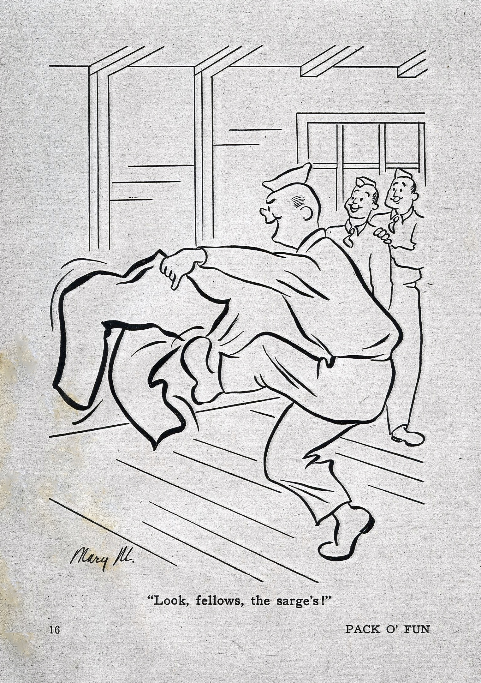
Notes:
Another cartoon by Mary - again note that she signed it “Mary M.” instead of Mary Blakley. Interesting.

Slide 17
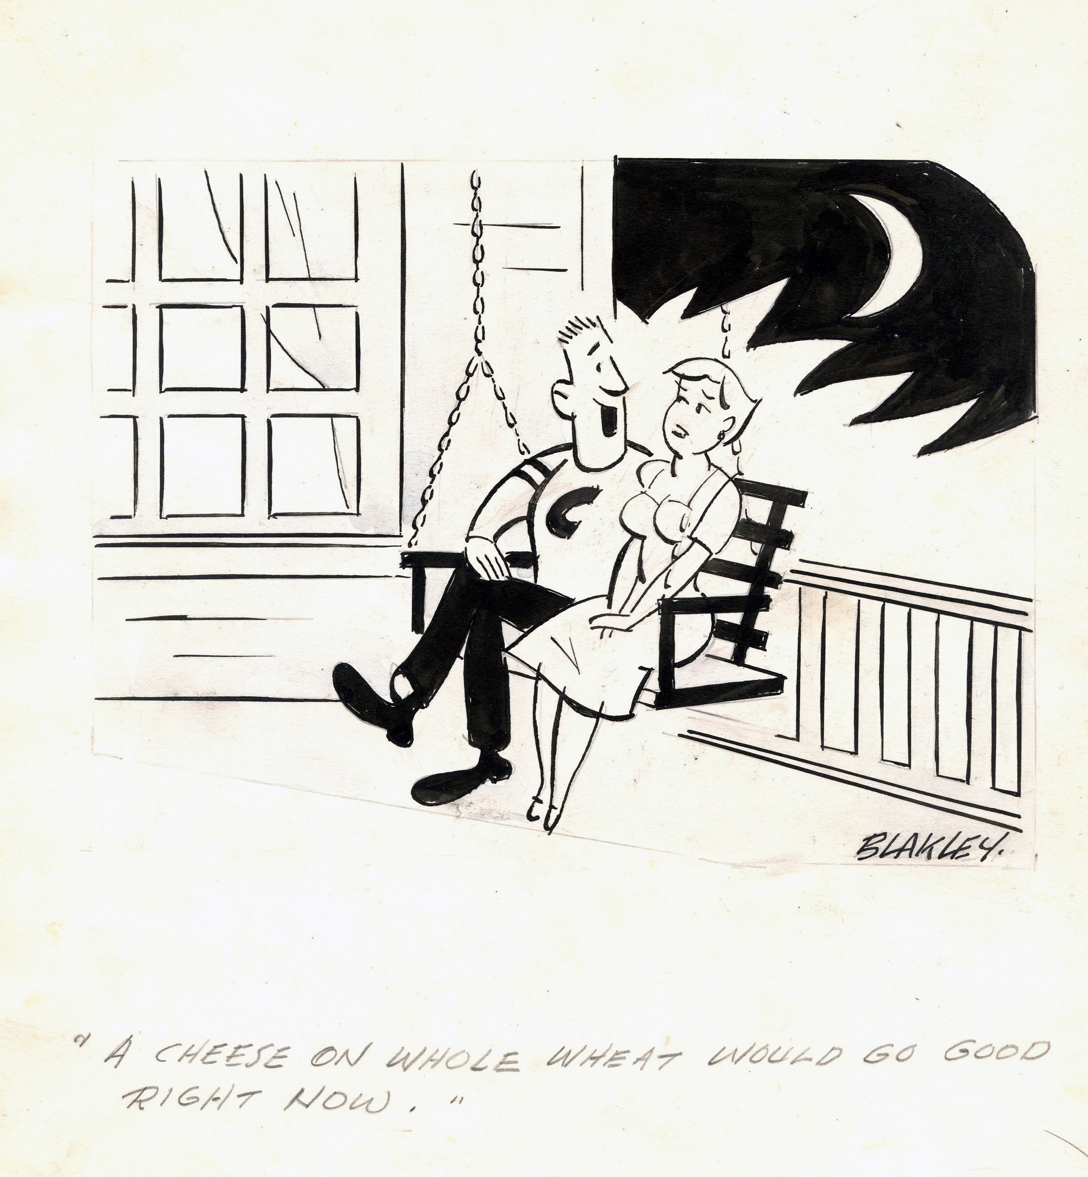
Notes:
An example of Tom’s puckish humor - the caption reads, “A cheese on whole wheat would go good right now.”

Slide 18
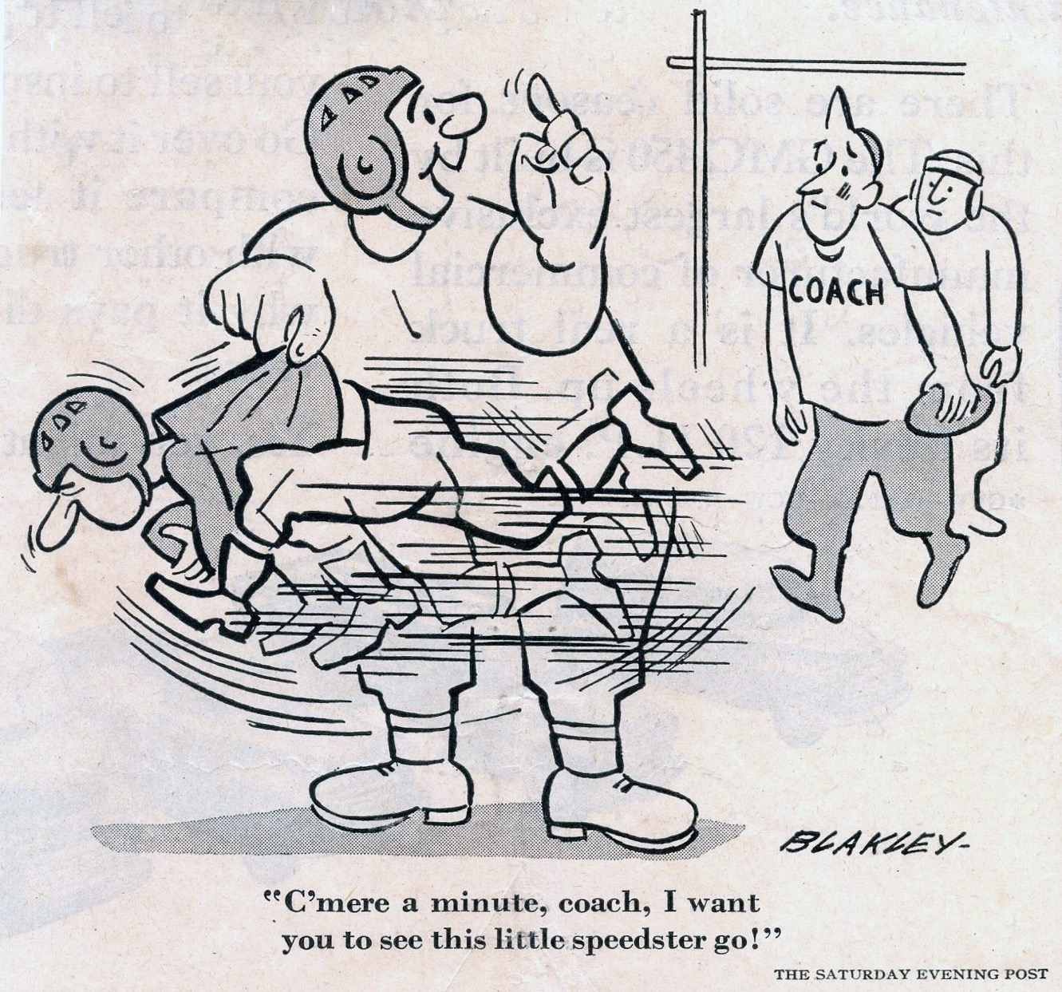
Notes:
This cartoon appeared in the November 18, 1950 issue of the Saturday Evening Post.

Slide 19
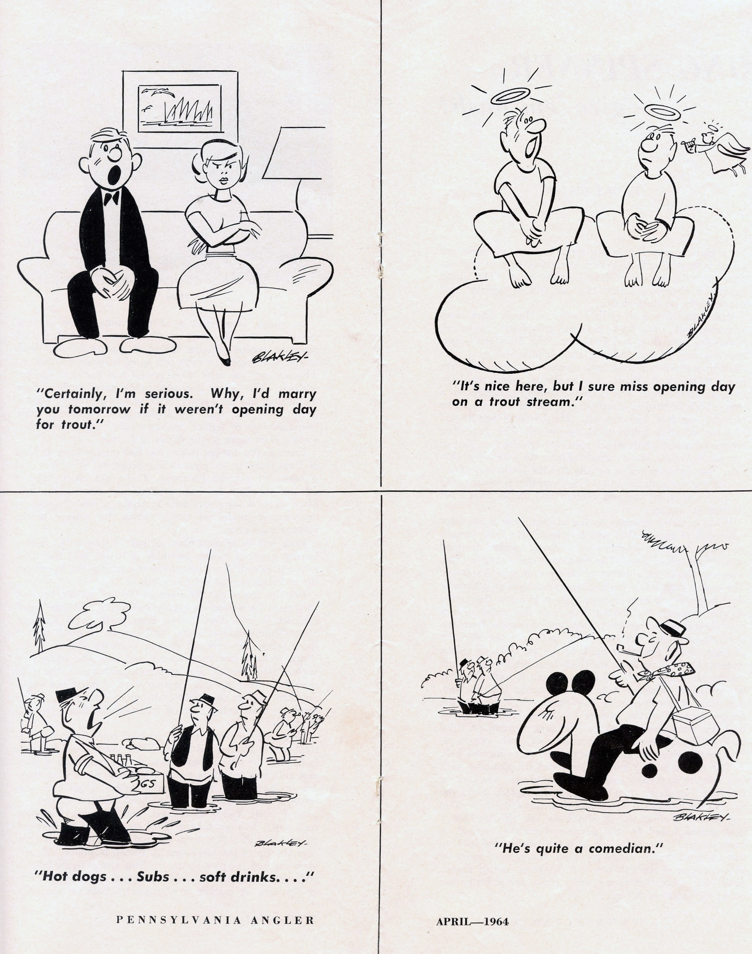
Notes:
4 cartoons from the April, 1964 issue of Pennsylvania Angler by Tom Blakley

Slide 20
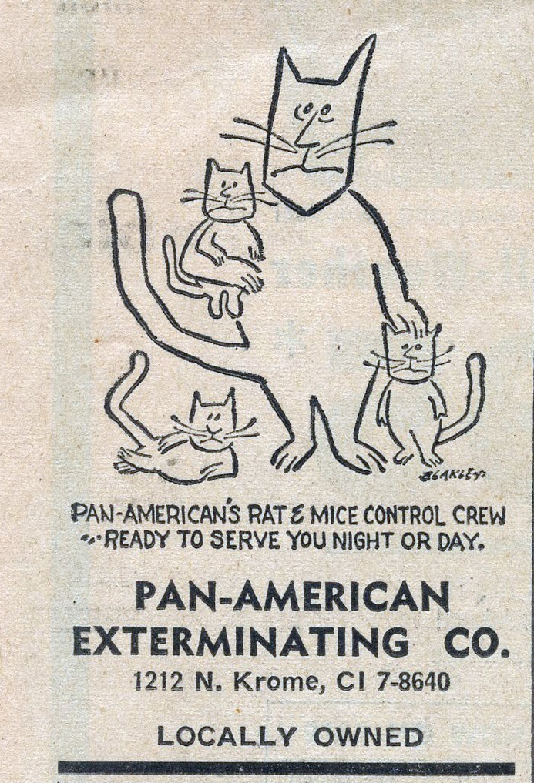
Notes:
A cartoon for the Pan-American Exterminating Company here in Homestead.

Slide 21
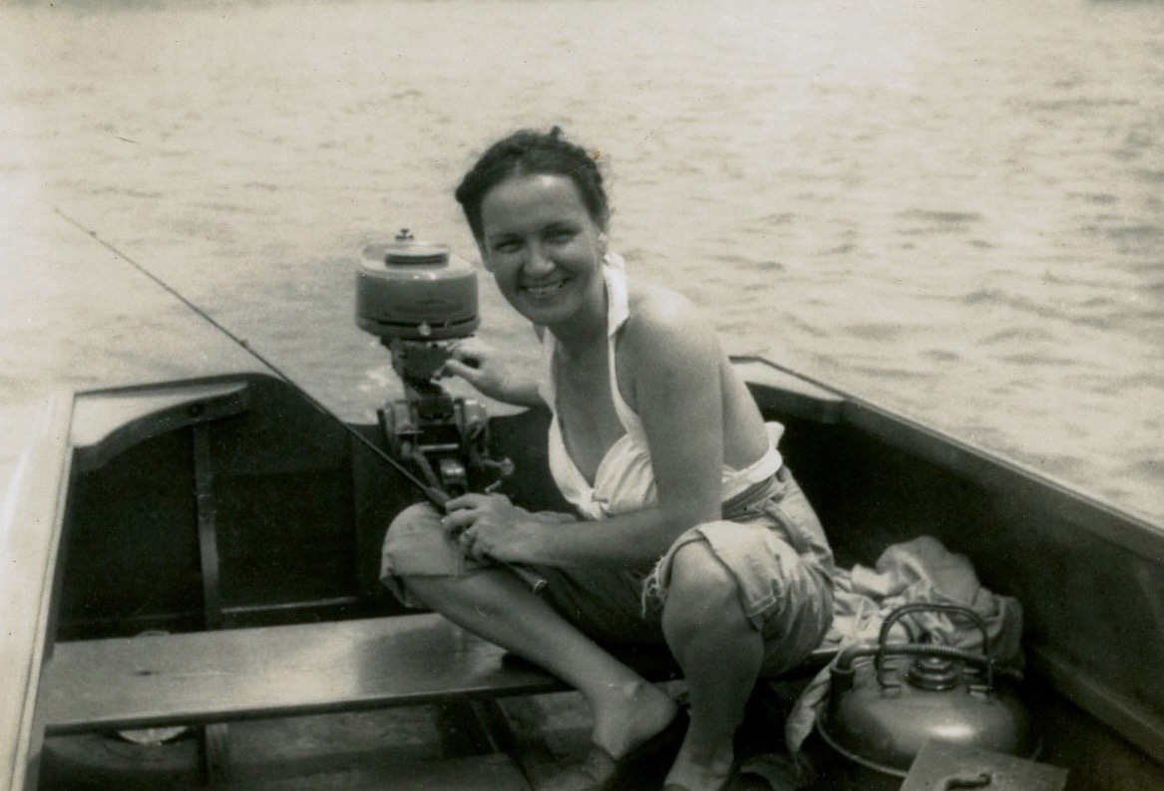
Notes:
Tom played football and participated in track and field while he was in high school and he also ran a trap line to catch muskrat while he lived in Fort Wayne. Apparently, muskrat skins commanded a good price in those days. When he came to Florida, he fished the Turner River, Biscayne Bay and the Florida Keys. Here, he and Mary are on a fishing trip in an outboard skiff.

Slide 22
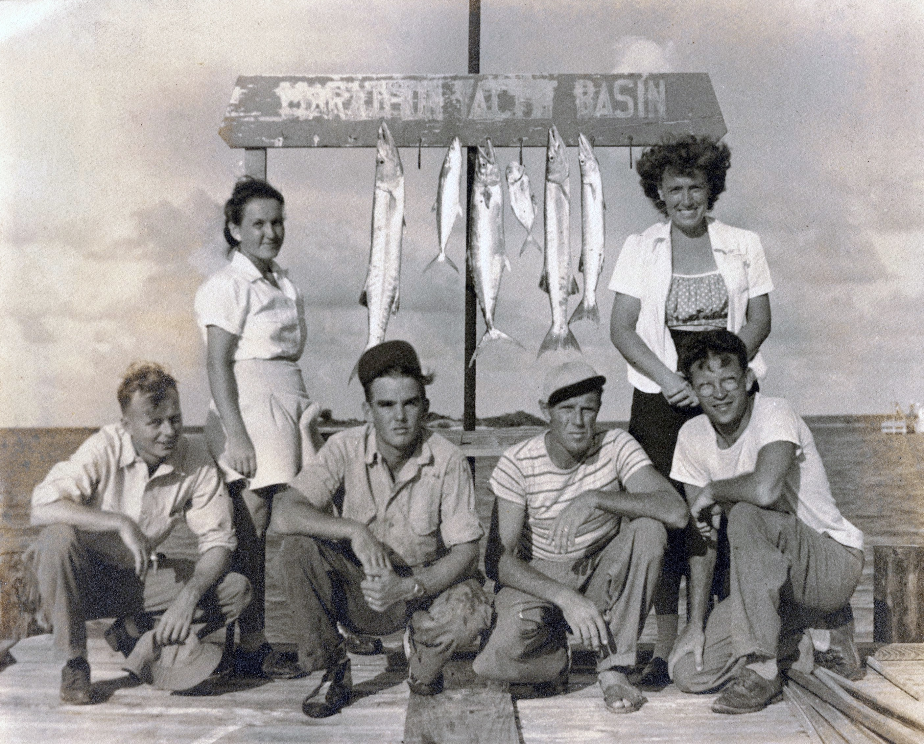
Notes:
Tom and Mary, on the left, and Mary’s brother and sister-in-law, John and Monica, on the right, in a photograph displaying their catch of the day. Their two fishing guides are in the middle. I’ve never done any research on where the Marathon Yacht Basin was, but it must have been in Marathon.

Slide 23
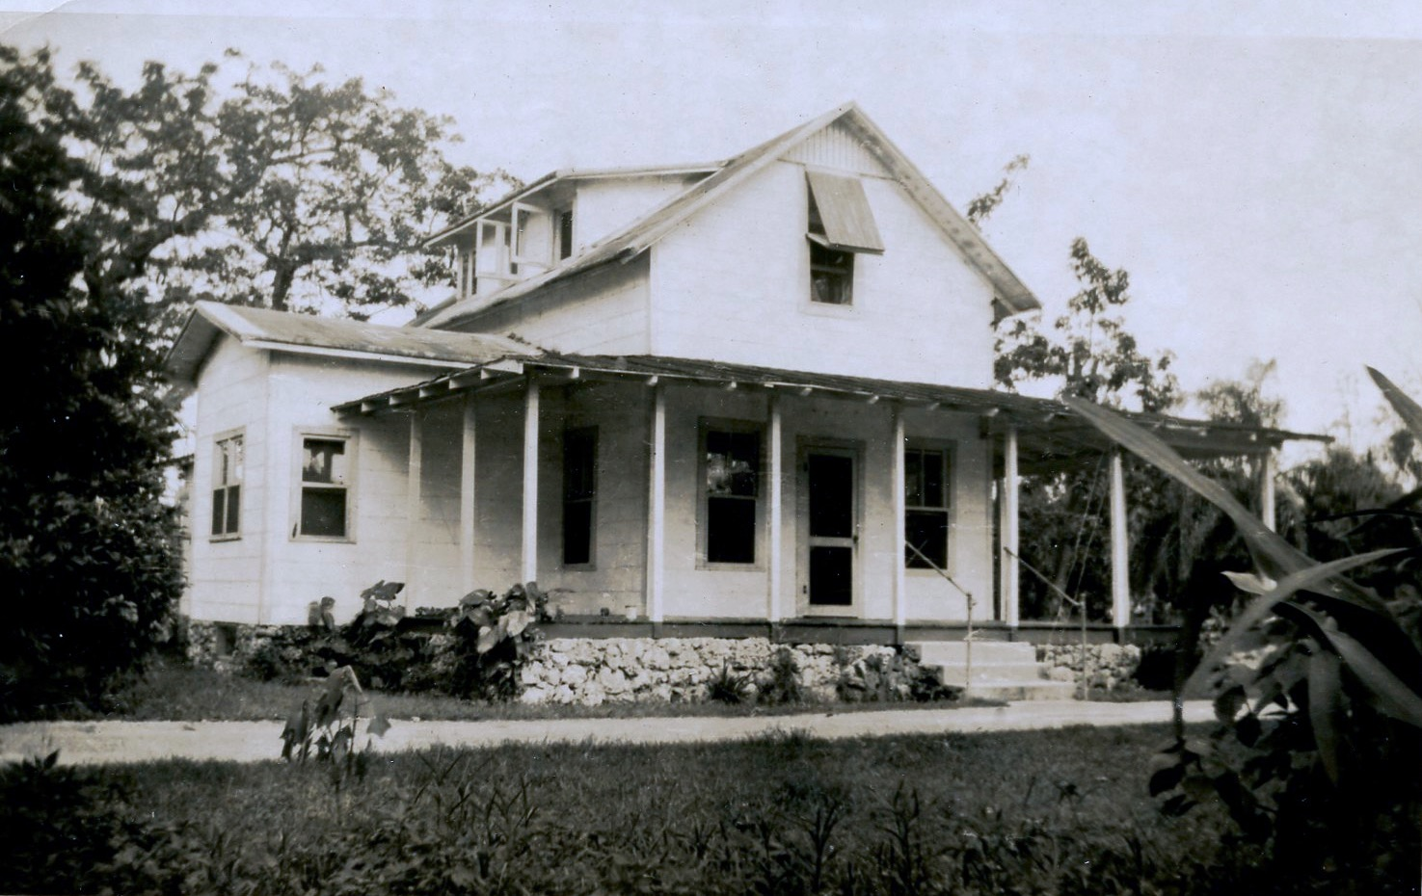
Notes:
In 1949, Tom and Mary, with one son, Mike and another on the way, moved out of their cramped quarters in a garage apartment behind Mary’s mother and aunt’s house in Miami to this house, just north of Homestead, which was owned by Ernst Bitte. George Grunwell kindly identified the owner of the property. The house is gone now, but it was located just north of Bauer Drive on the east side of Krome Avenue. The property is an avocado grove now.

Slide 24
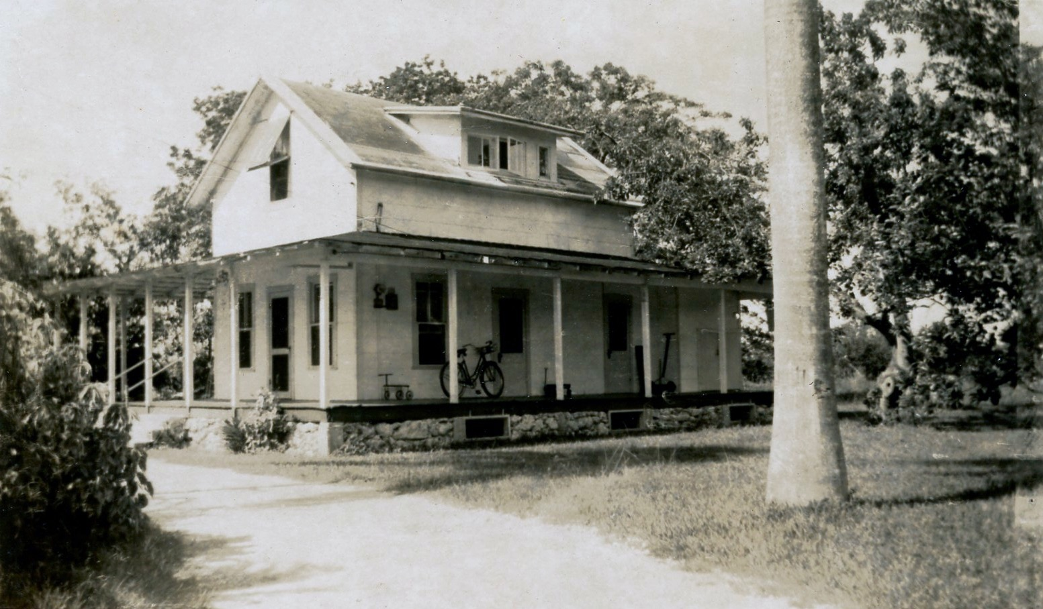
Notes:
The south side of the Bitte house. Tom and Mary only rented this house for a short time as they purchased their house on East Palm Drive in May of 1950, shortly after I was born in November of 1949.

Slide 25
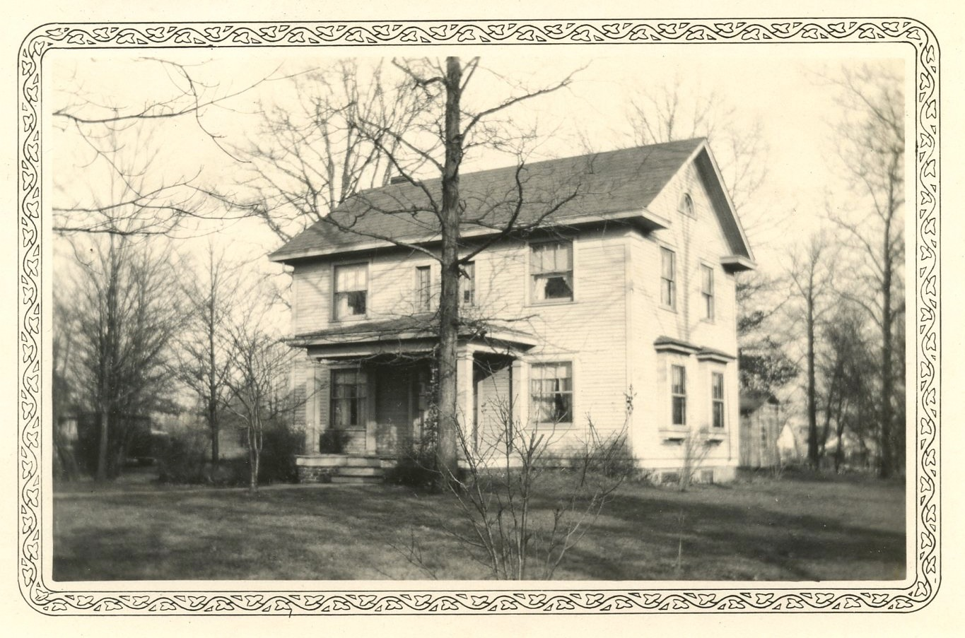
Notes:
Now, I want to back up in time a little bit. This is the house in Fort Wayne that Mary, from the age of 7, grew up in. Her parents had purchased it in 1919 for $7,000, an amount equivalent to $95,552 in today’s dollars.

Slide 26
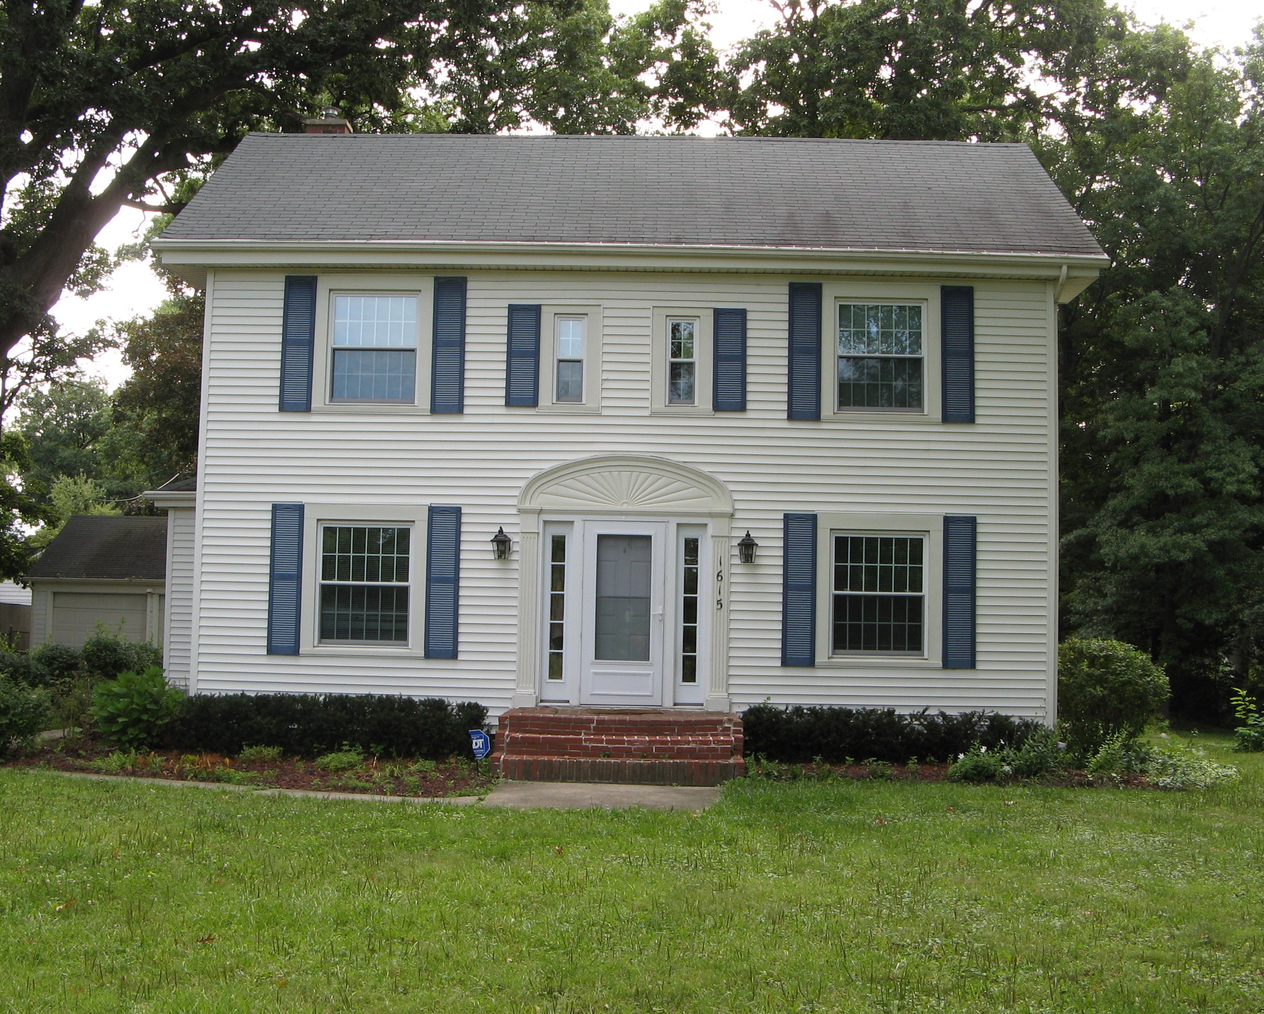
Notes:
And this is how the house looked in 2006. It is now in the Wildwood Park Historical district. Mary’s mother sold it in 1942 for $5,100. Considering that the country had not yet recovered from the Depression, that wasn’t that bad of a price.

Slide 27
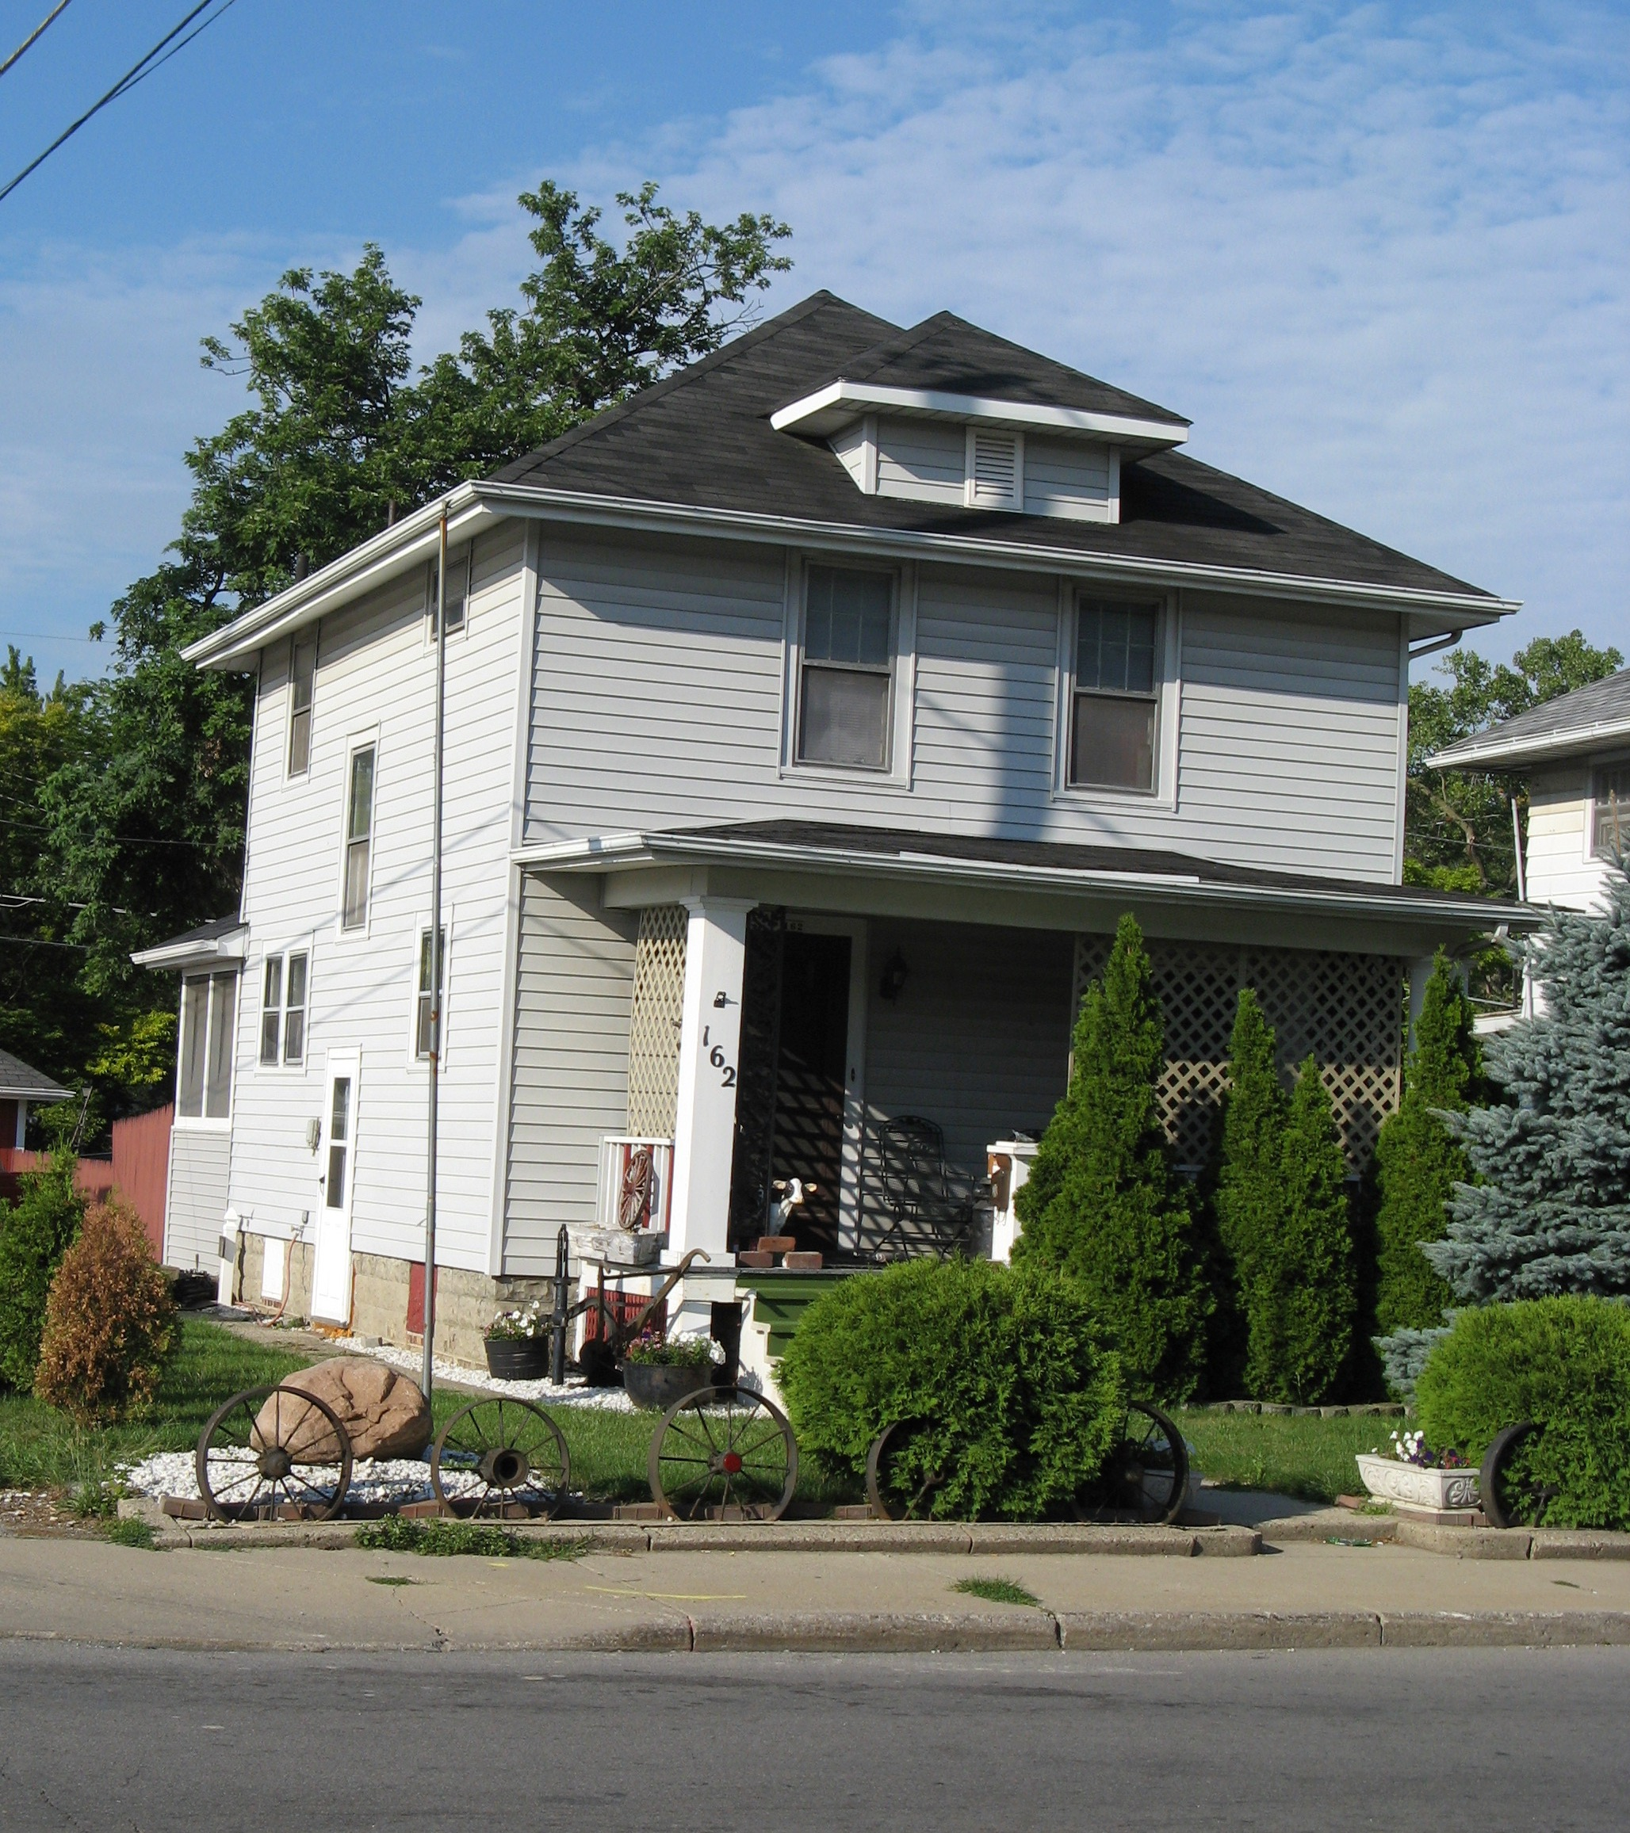
Notes:
This is the house, at 162 State Street in Fort Wayne, that Tom grew up in - he lived here until 1930, the year he graduated from high school. This photo was also taken in 2006.

Slide 28
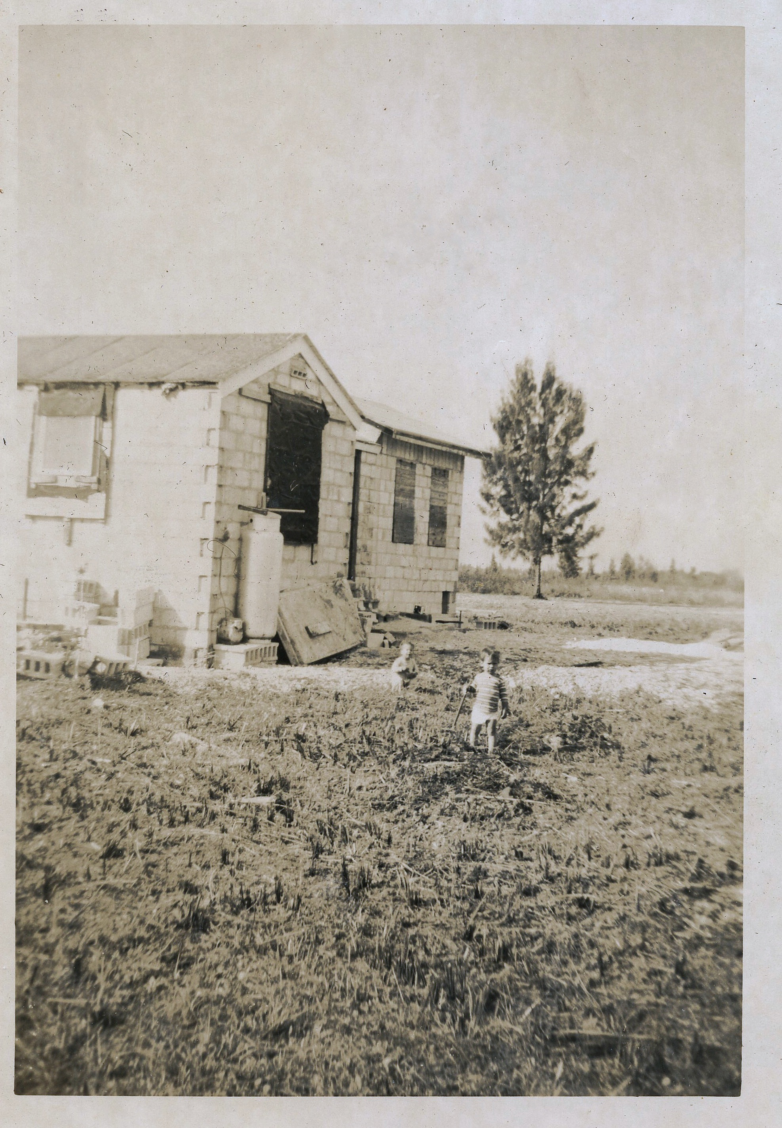
Notes:
And this is a picture of the front of Tom and Mary’s house, taken in early 1951, from the intersection of Tennessee Road and East Palm Drive. I find it very interesting that the two of them, both with pretty solid middle-class credentials, ended up buying this house. People often ask why Tom and Mary came to Homestead. The answer is affordable housing. They were both artists and rebels and because of that, they didn’t have much money. They couldn’t afford to buy a house in Miami and all Tom needed for his work was a post office box to access the markets for his cartoons. Tom was also a big fan of John Gifford’s book, Living by the Land, which promoted the possibility of food independence in the tropics. That remained a dream - Tom was an artist, not a farmer.
They bought the house on May 27, 1950, for $3,000. Tom put down $500 and financed the balance with a $2,500 mortgage at 6%. The little boys are Jeff, in the background, and Mike, in the foreground. The house had a gas stove and refrigerator - a Coldspot. Note the gas tank in front of the bedroom and the fact that the house has no windows yet - just shutters. Hopefully, the window openings had screens. I imagine that the mosquitoes must have been fierce in the summer! Note that there is no fill in the front yard yet, either. The land was a sawgrass prairie with a few Australian pines scattered about.

Slide 29
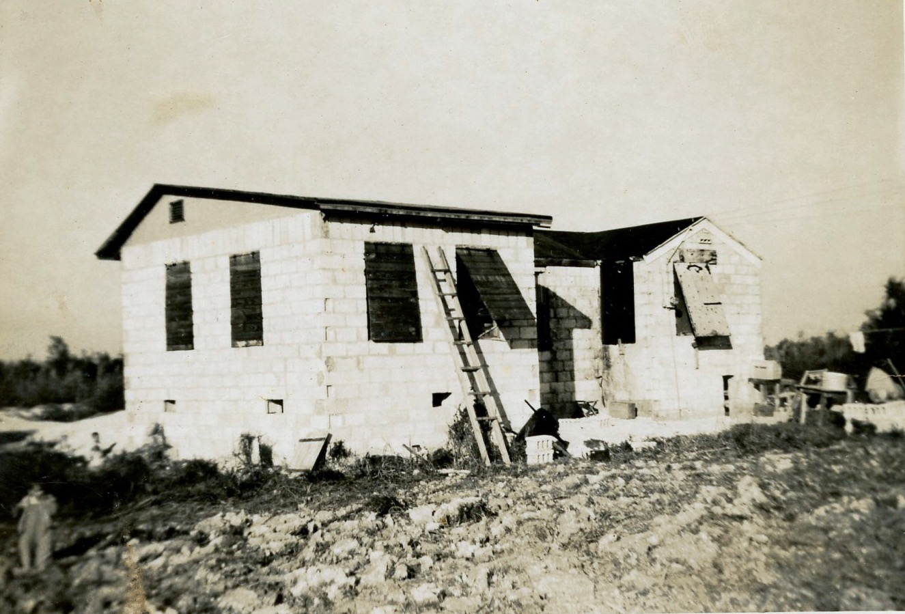
Notes:
This is the back of the house, looking towards the Florida City Canal. The kitchen is on the right and Tom’s studio is on the left. The original house consisted of 4 rooms: a kitchen, a bathroom, a bedroom and a living room. Note the presence of the shutters - there were no windows in the house yet. I imagine that there were screens in the openings to keep the mosquitoes out, but I don’t know.

Slide 30
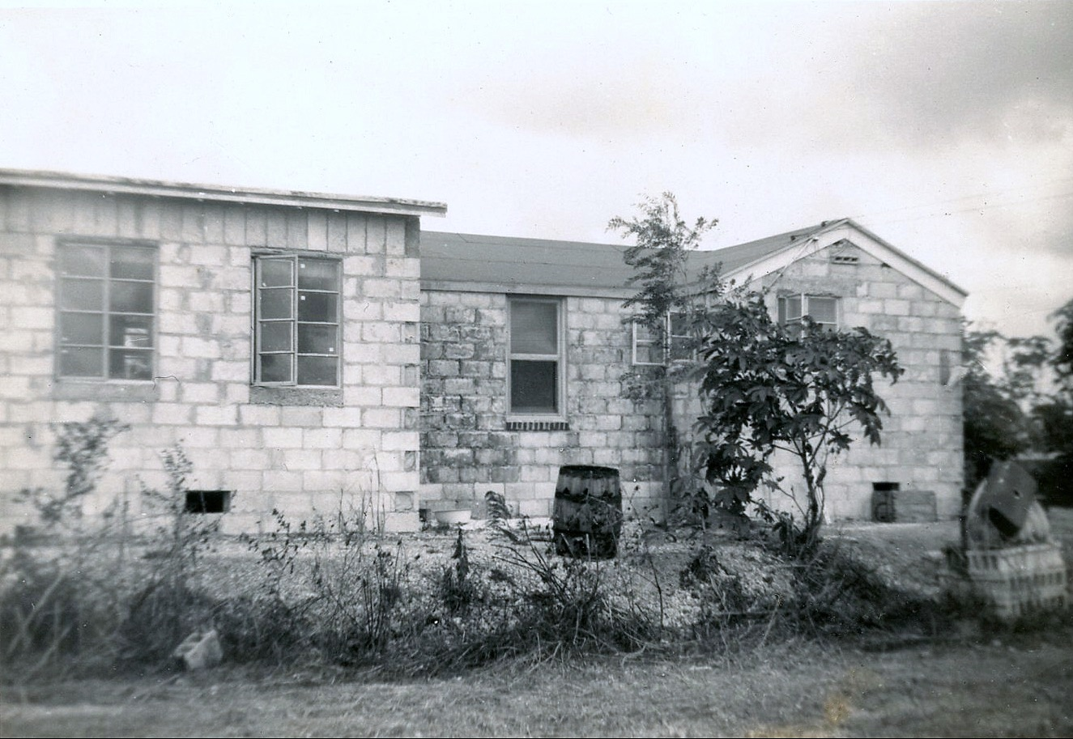
Notes:
The back of the house with the windows installed. The stack of concrete blocks at the right side of the photograph is where the water well was. The house had electricity, but there was no running water when Tom and Mary bought the house. Tom drove the well with a sledge hammer, using a well point and there was a pitcher pump until the plumbing was completed. I don’t think the house was finished when Tom bought it - he probably kept his family in the house on Krome Avenue until he made the house habitable. It was a bit of an adventure, to say the least, especially compared to houses that existed just one mile to the west in Florida City.

Slide 31
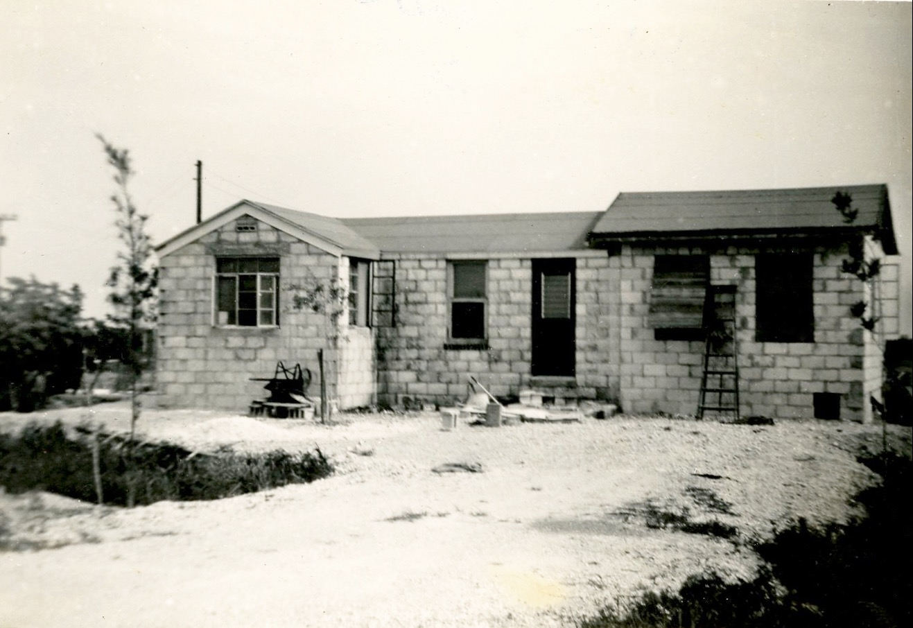
Notes:
A picture of the house taken before all of the windows were installed. Electricity to the house was supplied by the Florida Keys Electric Cooperative via a line that ran up Tennessee Road from Card Sound Road. The house, built in 1946 by George Anderson as a spec house, had no fill in the front yard so Tom had that brought in so that there was a place to park the car without it getting bogged down in the wet marl soil.

Slide 32
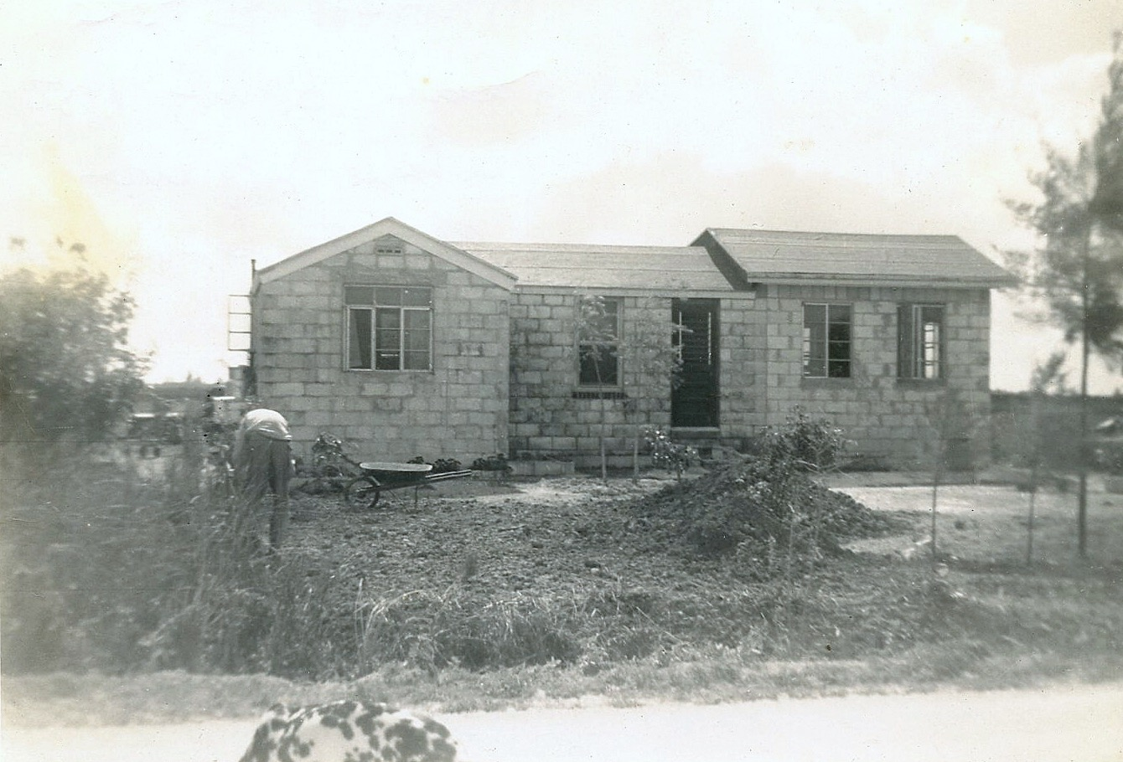
Notes:
The front of the house, with all of the windows installed, taken from East Palm Drive. Note the Dalmatian dog in the photograph, wandering about in the middle of East Palm Drive. Not much traffic in those days! Tom is bent over, planting a tree.

Slide 33
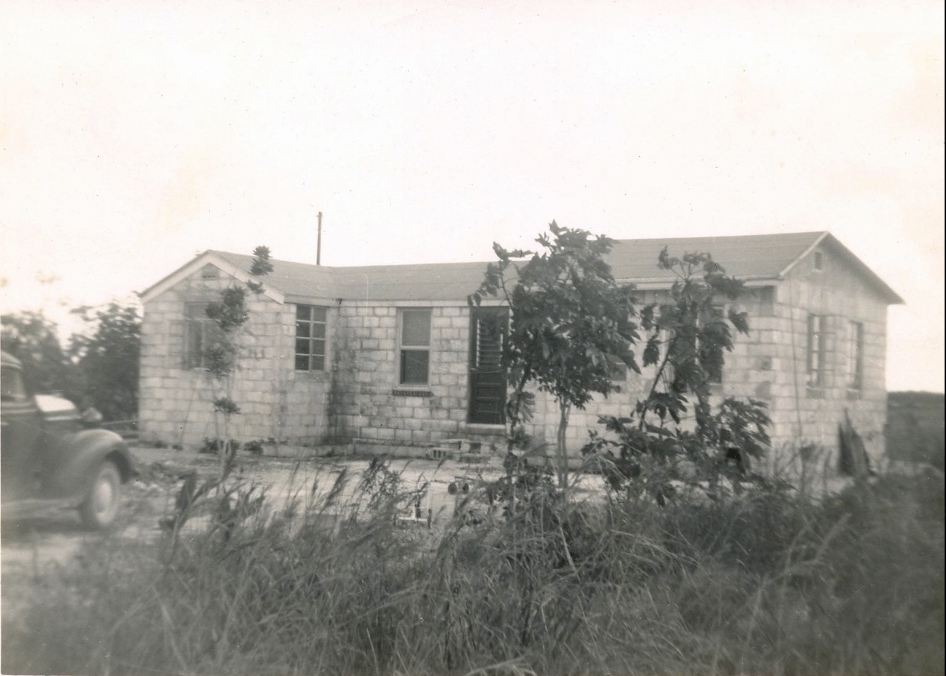
Notes:
Another shot of the front of the house, with Tom and Mary’s 1938 P6 Plymouth on the left side of the picture. This photo was taken in 1952, when the Plymouth was 14 years old.

Slide 34
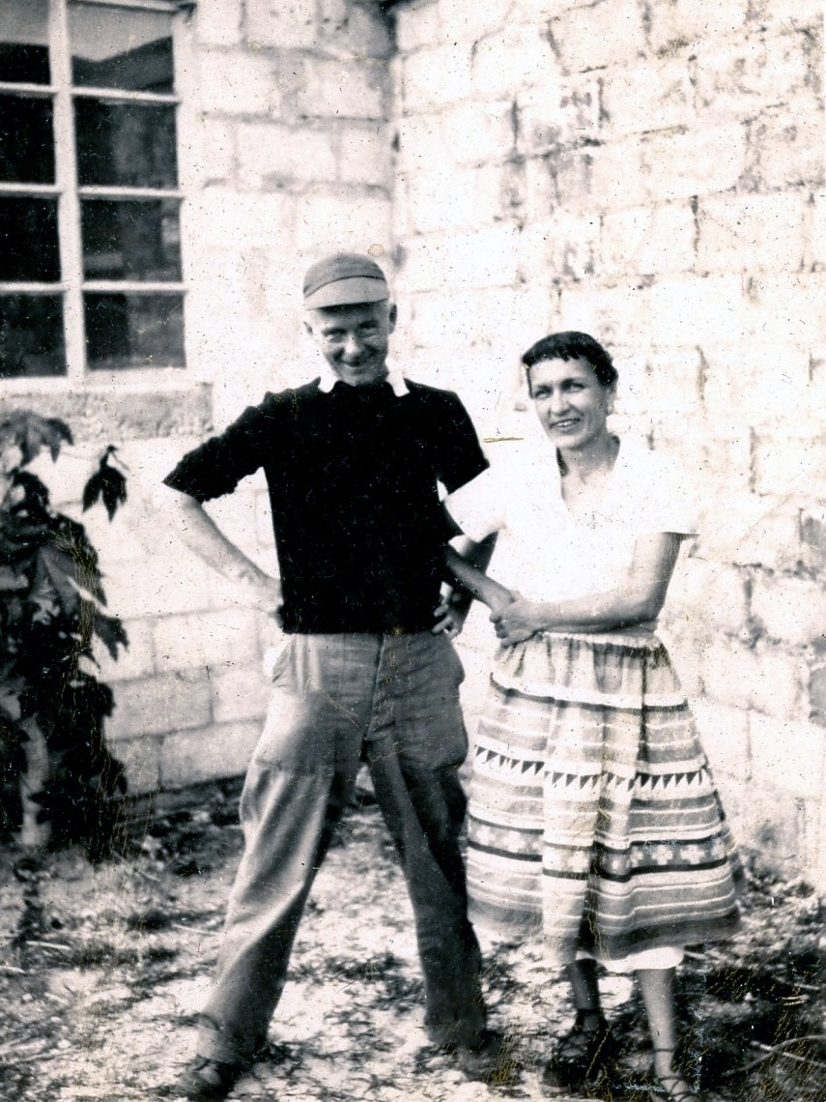
Notes:
Tom was fascinated with Native Americans and like to pull people’s legs by telling tall tales about his encounters with them when he was a child. Not that he had any encounters with Native Americans in Fort Wayne, though! Here, he and Mary are standing behind their house with Tom’s studio in the background. Mary is wearing an authentic Seminole Indian dress that she may have purchased at one of the tourist stops on the Tamiami Trail.

Slide 35
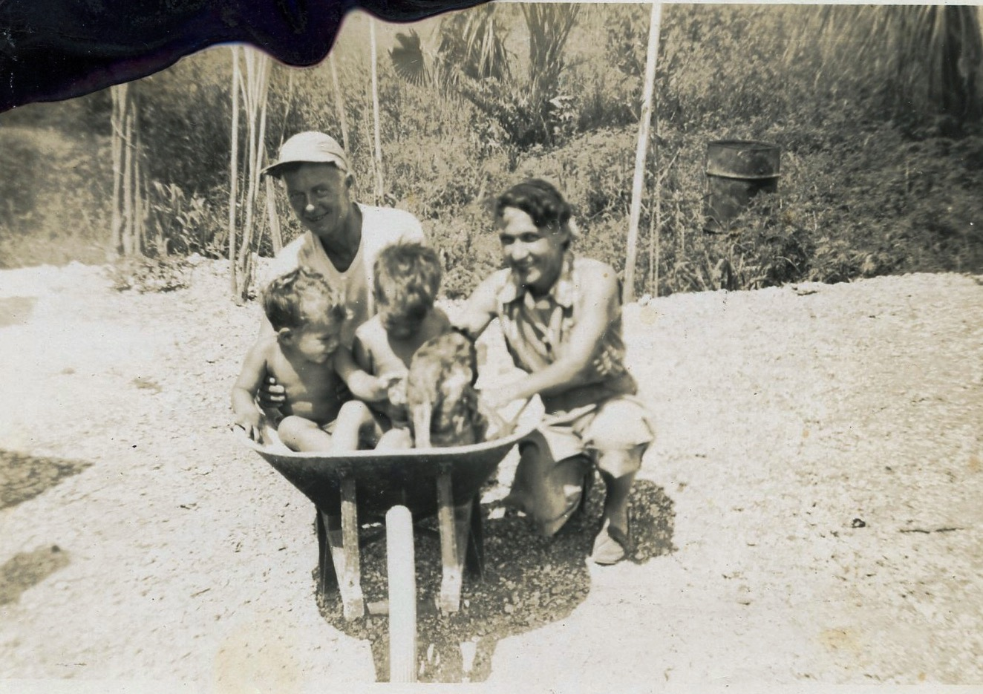
Notes:
A family portrait, taken in 1952. Mike and Jeff are in the wheelbarrow, with the family dog, while Tom and Mary are kneeling on the lime rock fill in the back. The fill was brought in - the land was marl prairie. The oil drum in the background was used to burn trash in - there were no municipal services in the area at that time. Garbage pickup from the City of Florida City didn’t start until the year 2000.

Slide 36
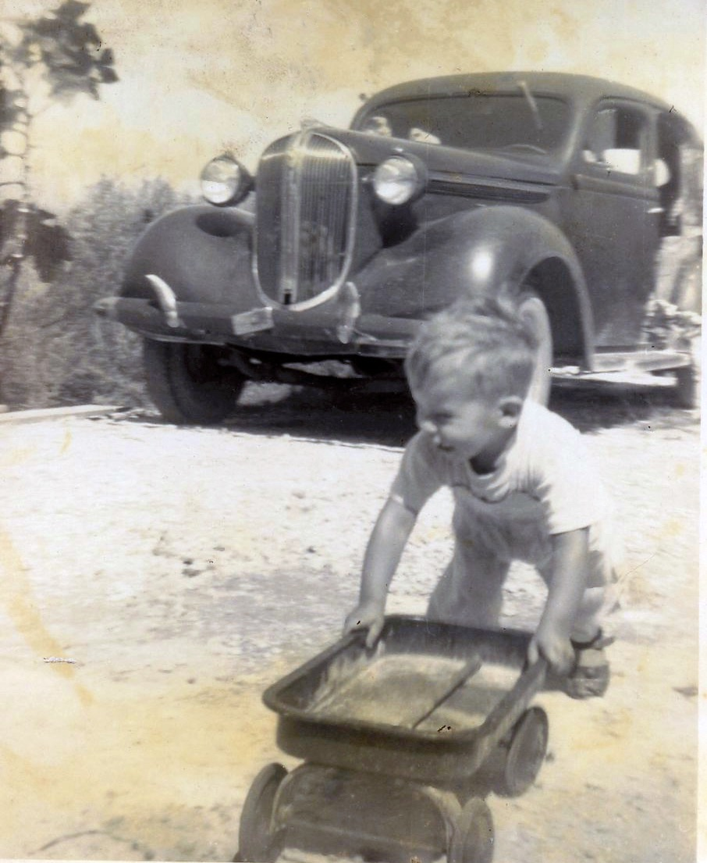
Notes:
This is a picture of Jeff in the front yard of the house in 1952 with the 1938 P6 Plymouth in the background.

Slide 37
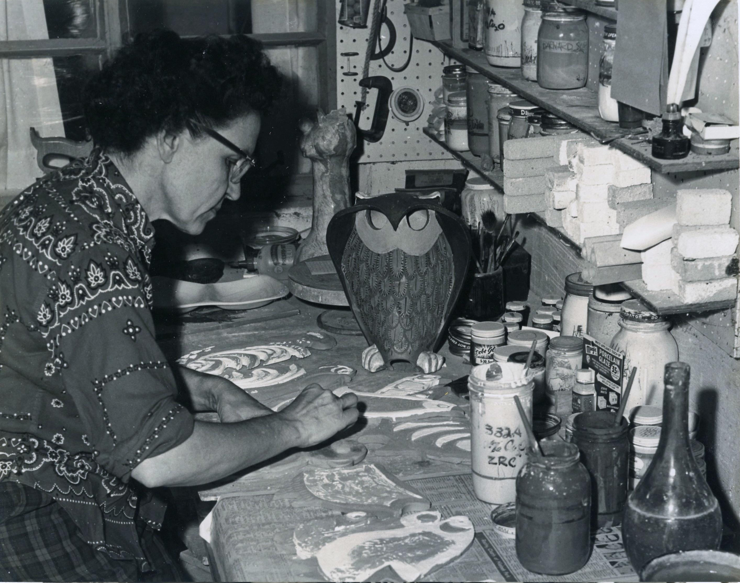
Notes:
Mary started working in clay as early as 1947 but didn’t start doing it seriously until the mid-1950s, when she took a class at the Redland Fruit and Spice Park. Here, she is working on the front porch of the house in 1961. This photograph was likely part of a series of photographs that were taken to illustrate several articles that she authored in the monthly magazine Ceramics Monthly.

Slide 38
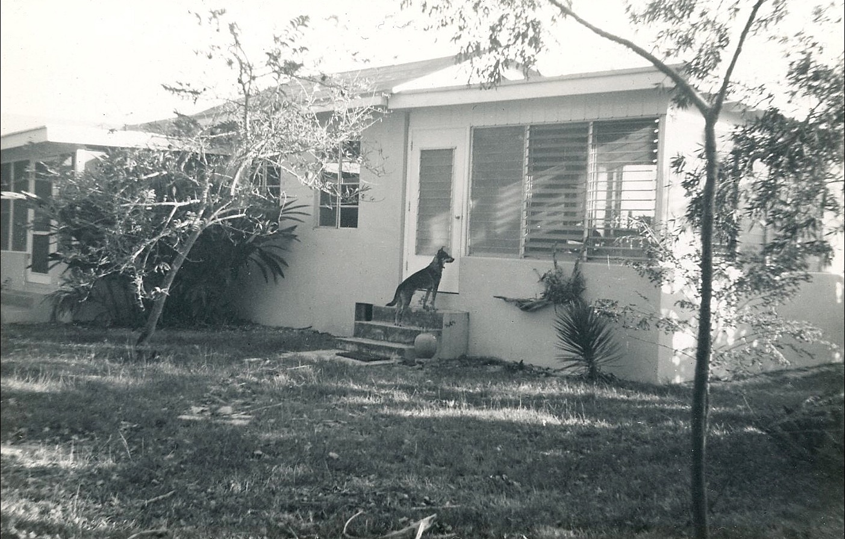
Notes:
The front of the house in the mid-1960s, with the family dog, Topo Gigio, named after the puppet on the Ed Sullivan Show. The dog is standing on the steps of the Florida room, added after the birth of their son, William, in 1958. This room later became the gallery, where Tom and Mary displayed part of the work they offered for sale.

Slide 39
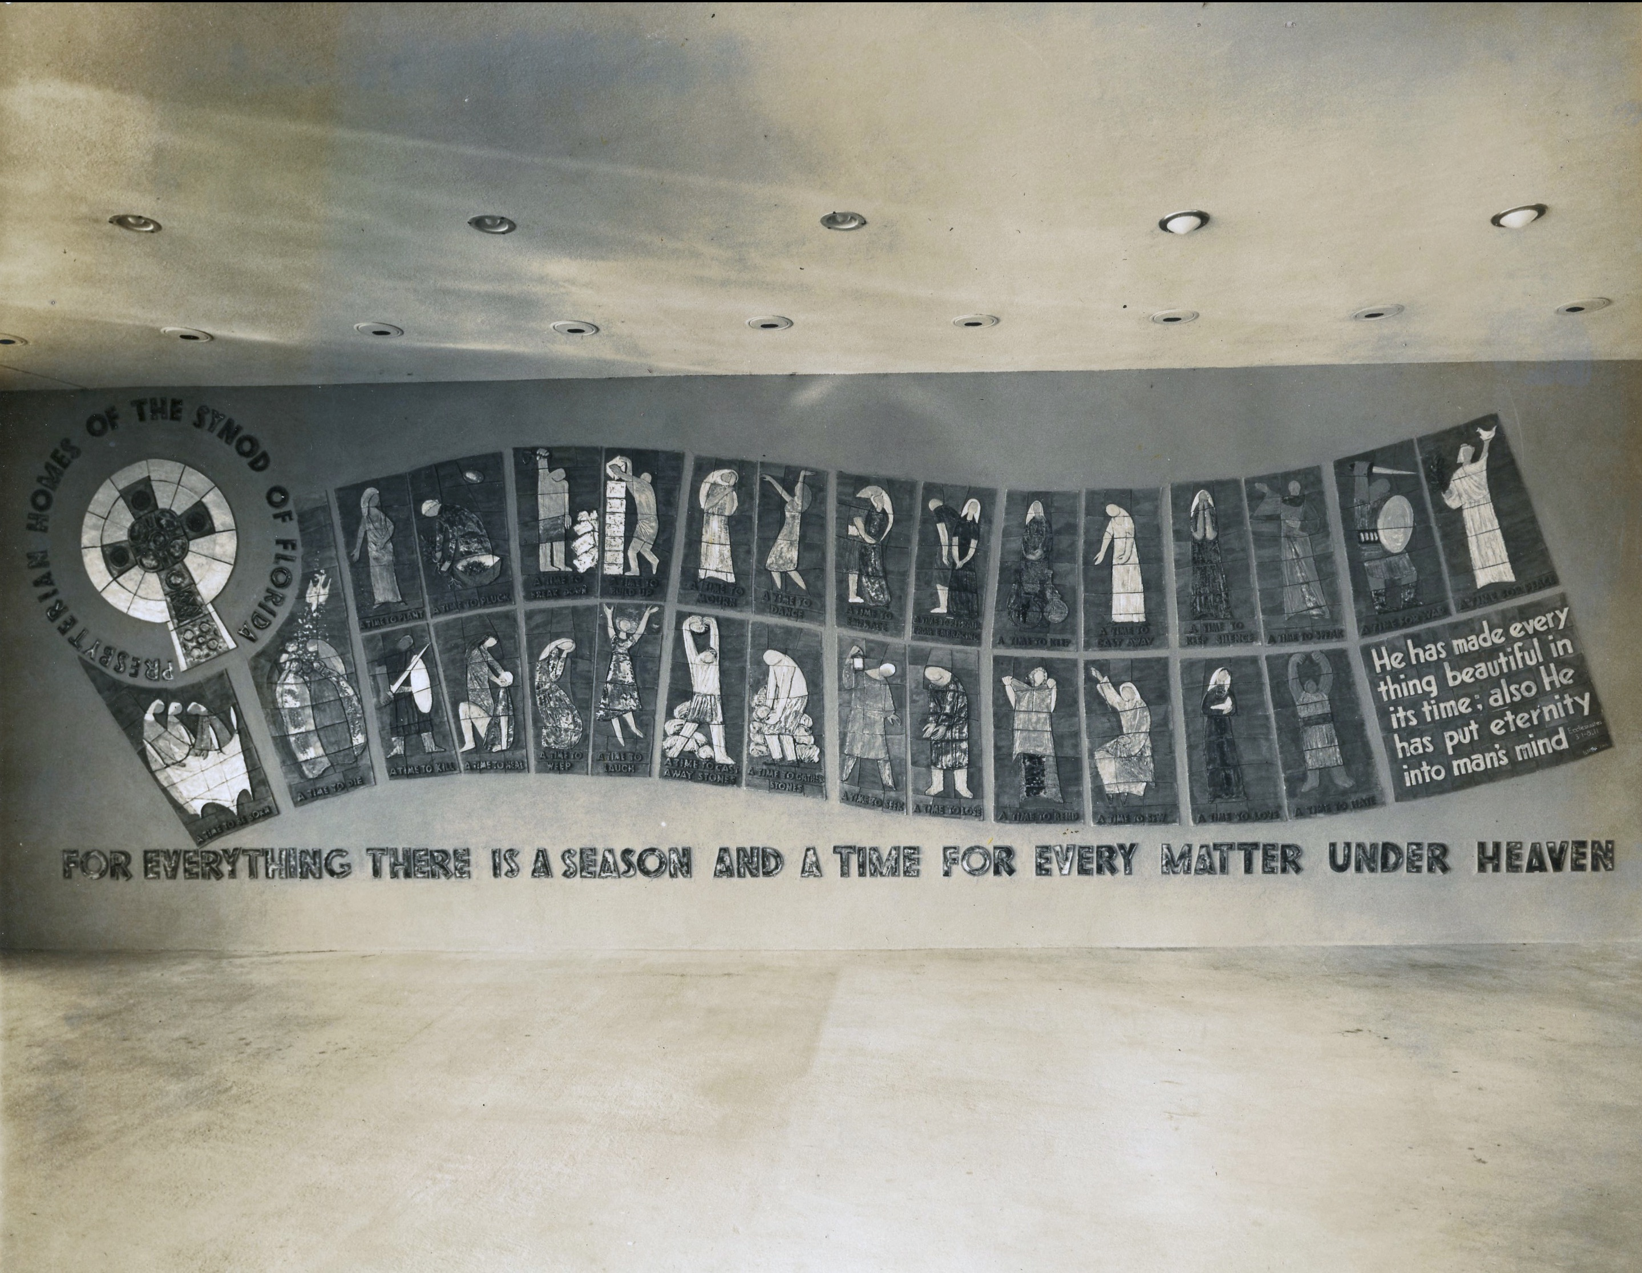
Notes:
Some time in 1964, Tom and Mary got the commission to create a mural for the new Presbyterian Retirement Home in Winter Park Florida. Mary was a member of the First Presbyterian Church and I have no doubt that Rev. Frank Elvery, who was the pastor at the time, was instrumental in Tom and Mary getting the commission. I was obviously too young at the time to be privy to the details. The mural was created in the house and fired in a single small 110 volt kiln on the front porch. It was then packed into wooden boxes and hauled to Winter Park by Tom in a trailer towed behind their 1964 Rambler station wagon, where he supervised its installation.

Slide 40
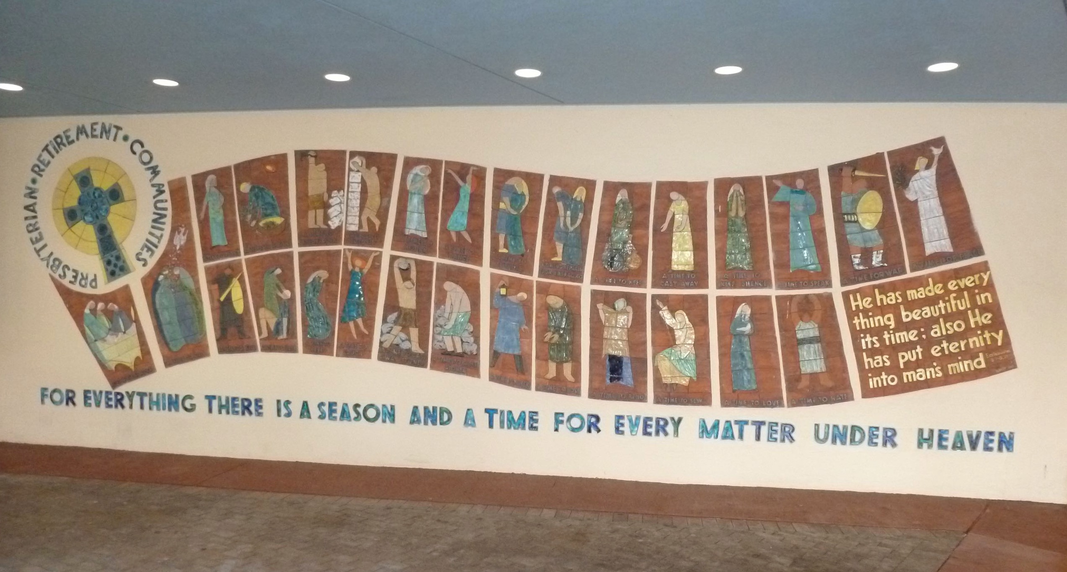
Notes:
I went to Winter Park for the first time last July to see the mural. I had never seen it in person before. The mural is 10’ tall and 30’ long. Some of the letters had been broken over the years - Mary made replacements for them in the late 1990s but the colors don’t quite match, as you can see if you look closely.

Slide 41
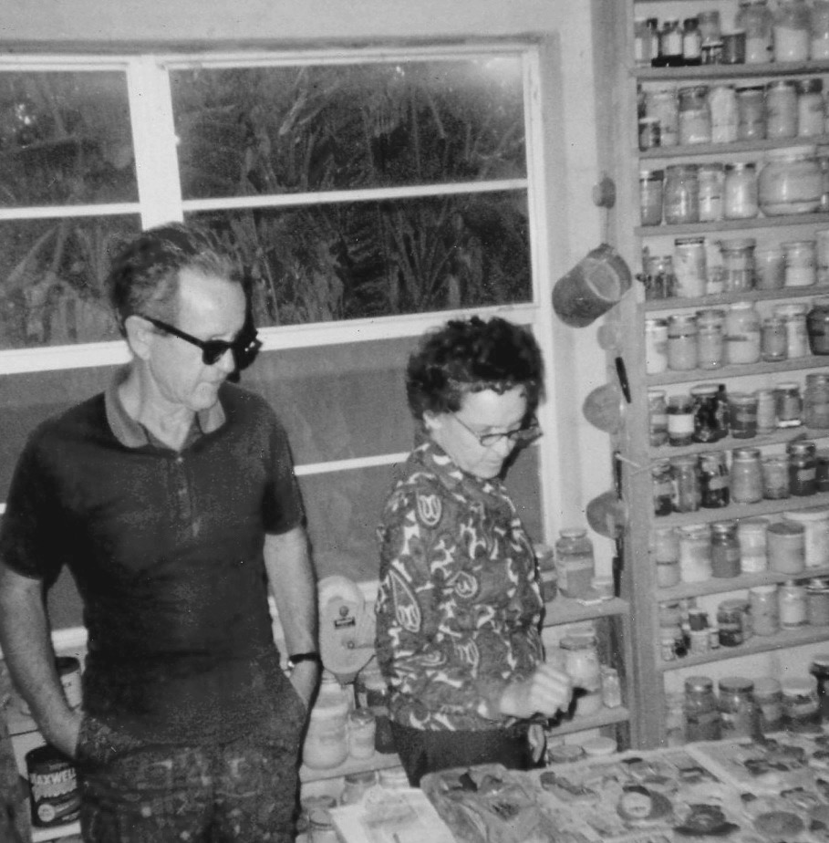
Notes:
Mary, with her brother Paul, in the new studio, which was built in by Bruce Batchelor in early 1966, and paid for with the income they got from doing the mural. The building of the shop was the starting point for Mary Blakley Ceramics - they finally had a place to work and create. This photograph was taken in 1968. Tom and Mary both made pieces for sale, but Mary glazed most of them. She was a colorist, first and foremost and had the ability to envision what the finished pieces would look like. Ceramic glazes are dull and not very colorful before they are fired. I learned, after Mary passed away, that she had a form of synesthesia, chromesthesia, in which she saw colors when she heard music. Mary took two summer classes at Julliard in New York City as a teenager and played the piano, though not well. She was very fond of classical music and had it playing often while she worked.

Slide 42
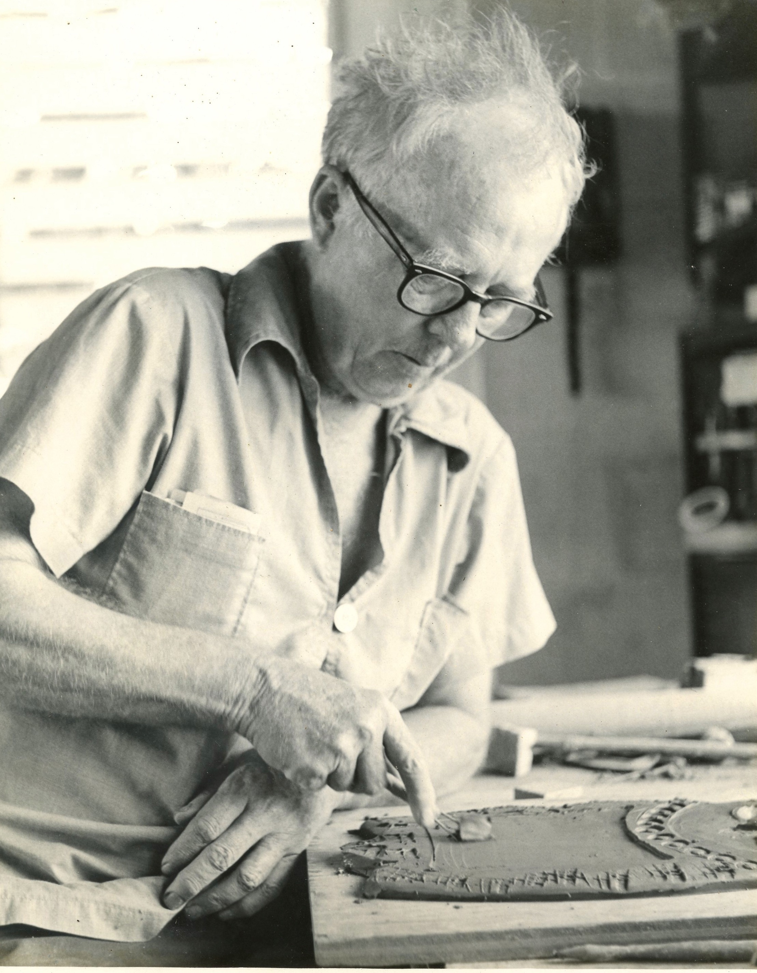
Notes:
Tom, at his work bench by the door of the studio. Here, he is making one of his well-known owls. This was a photo that appeared as part of an article published in the South Dade News Leader on December 9, 1971.

Slide 43
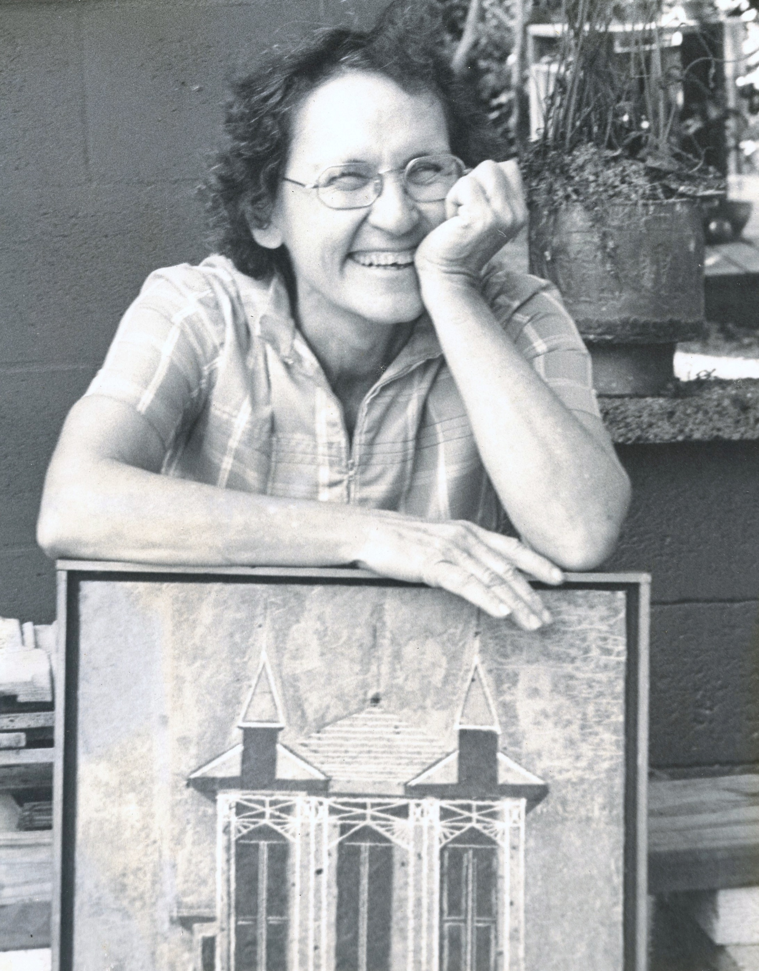
Notes:
Mary, in a photograph taken for the same article as the previous picture. Mary didn’t only work in clay - here she is posing with a piece done in acrylic and collage.

Slide 44
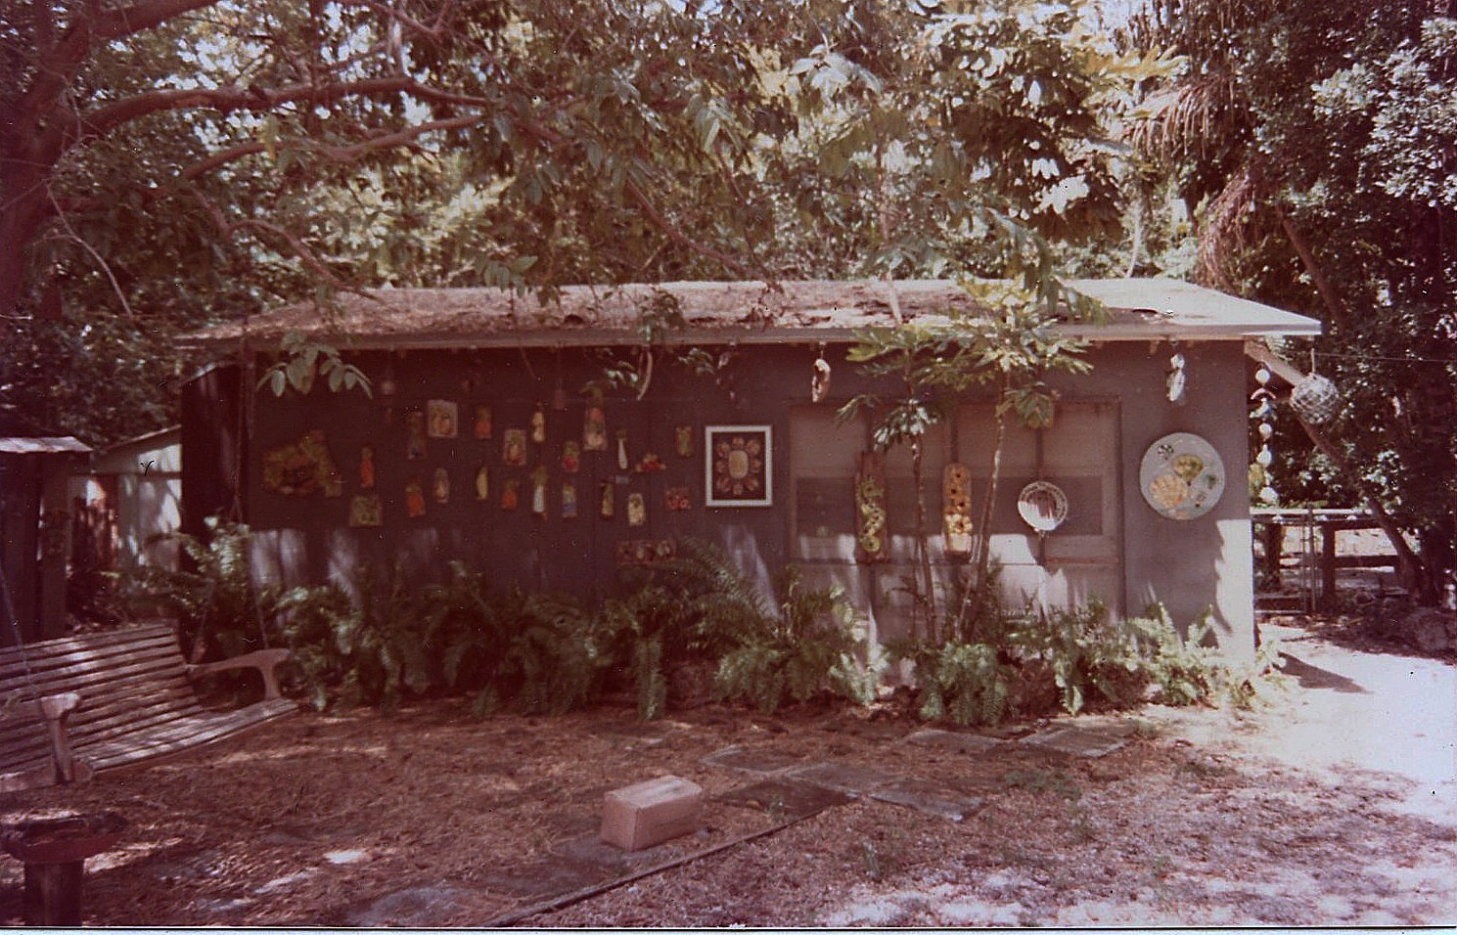
Notes:
This is the shop as it appeared in the early 1970s.

Slide 45
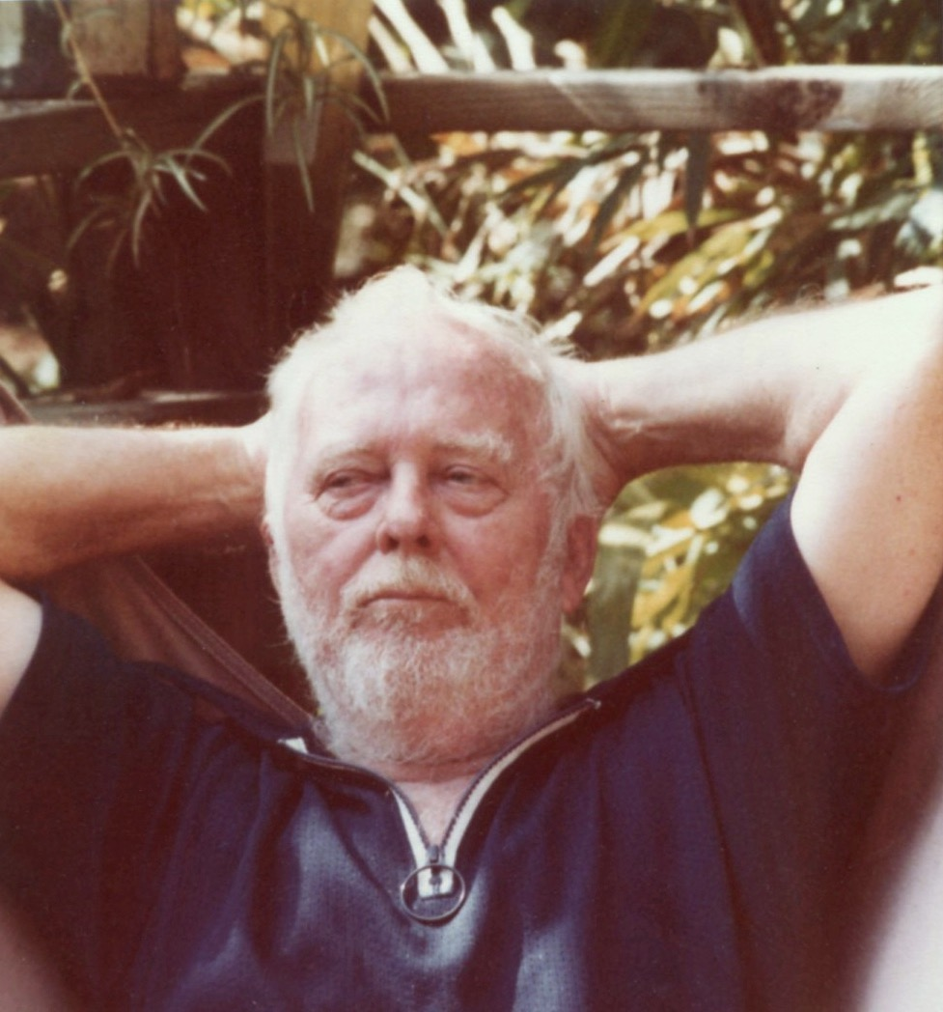
Notes:
A photograph of Tom taken in the early 1980s.

Slide 46
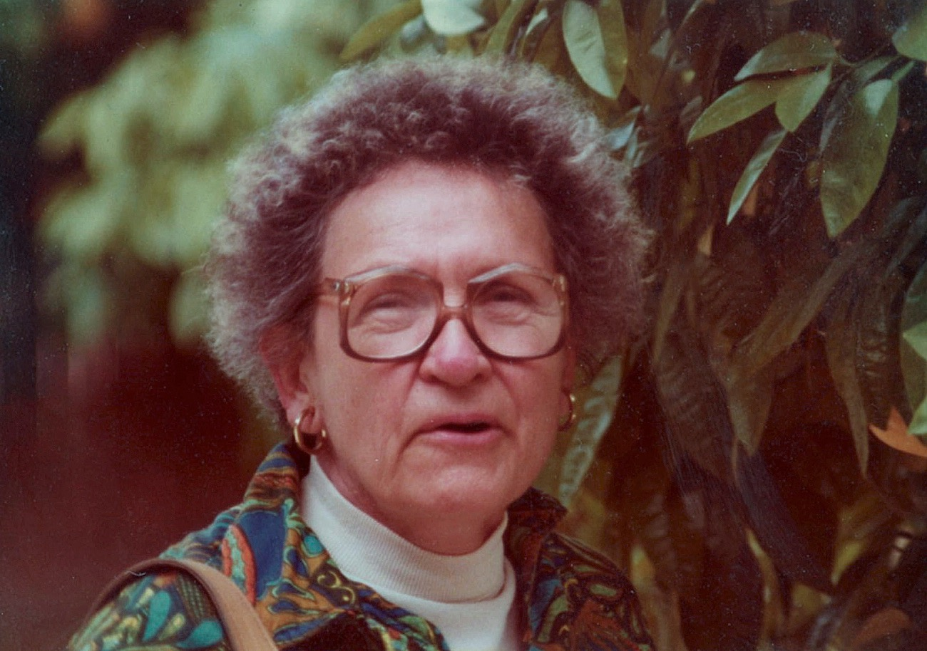
Notes:
And a photograph of Mary, also taken in the early 1980s.

Slide 47
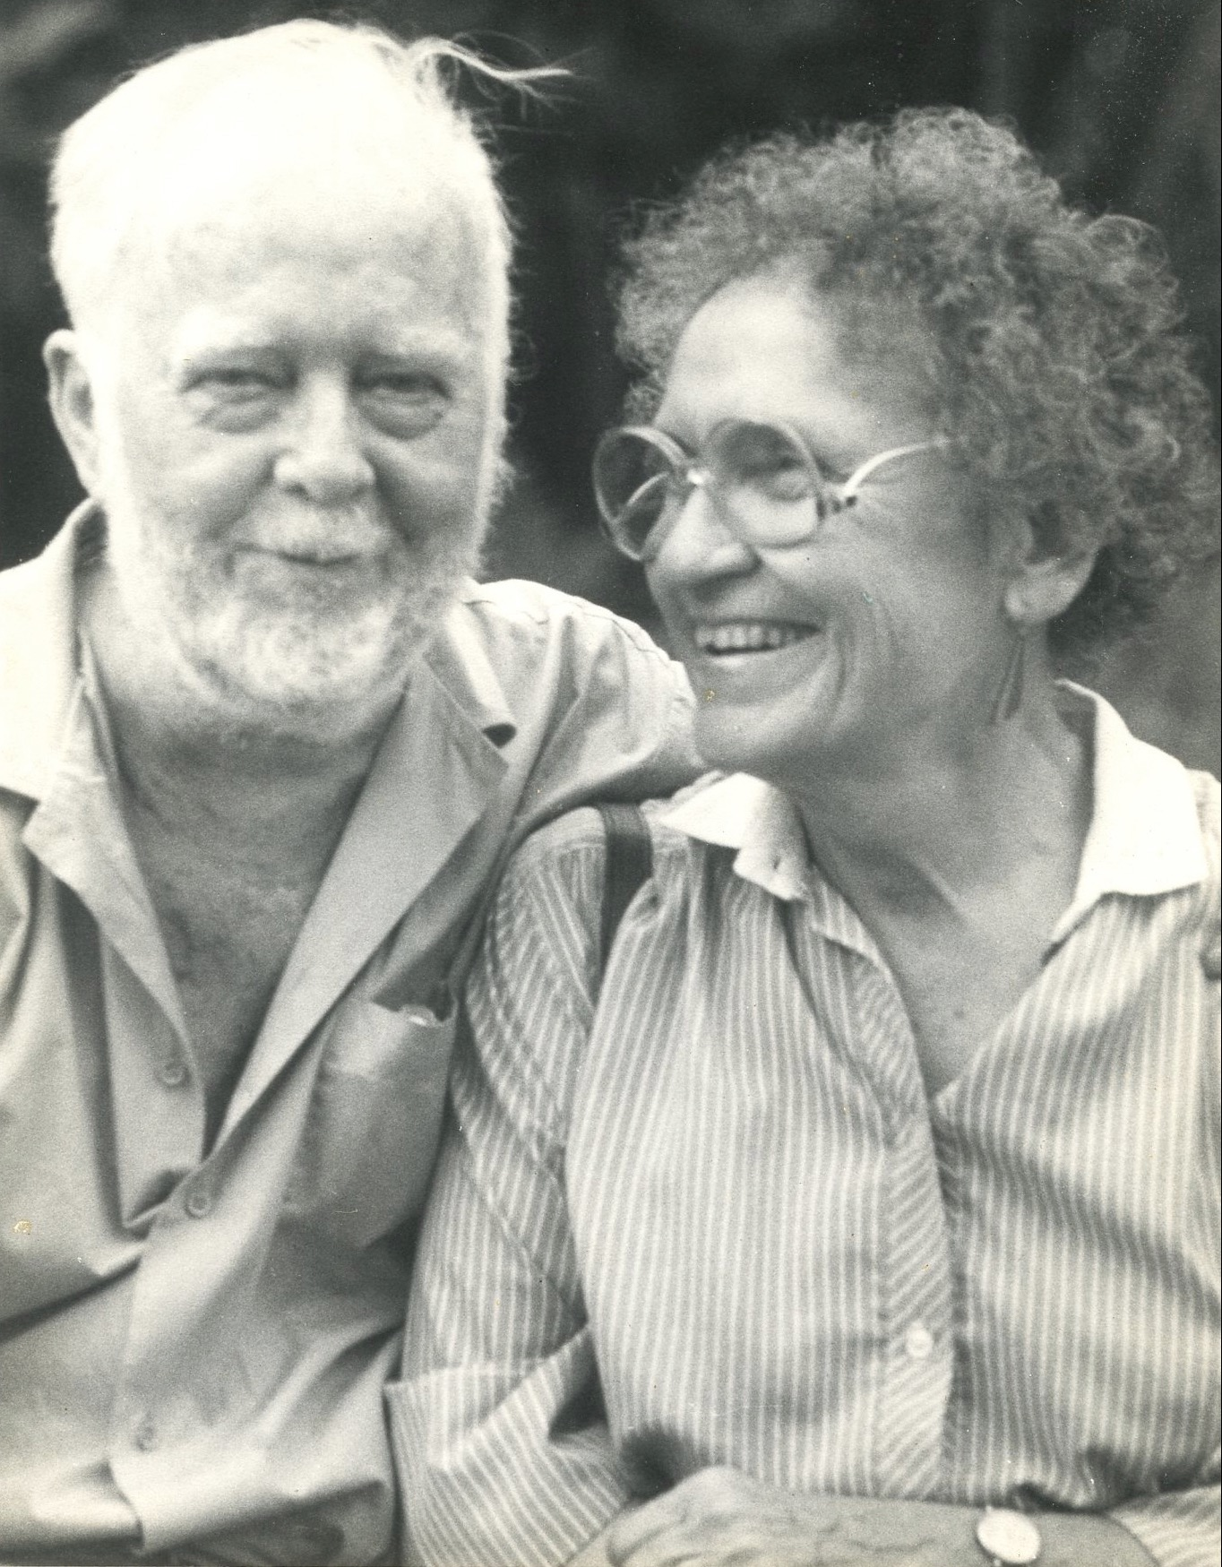
Notes:
Tom and Mary, in a photograph taken a few months before Tom died of lung cancer on August 30, 1984.

Slide 48
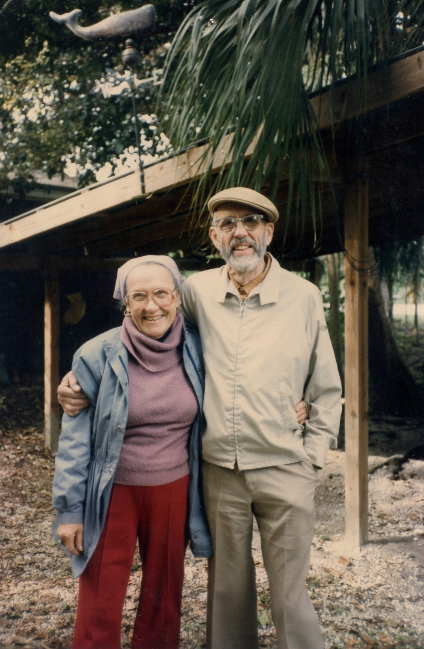
Notes:
This is Mary and her brother, Horace, in a photograph taken by yours truly in December, 1985.

Slide 49
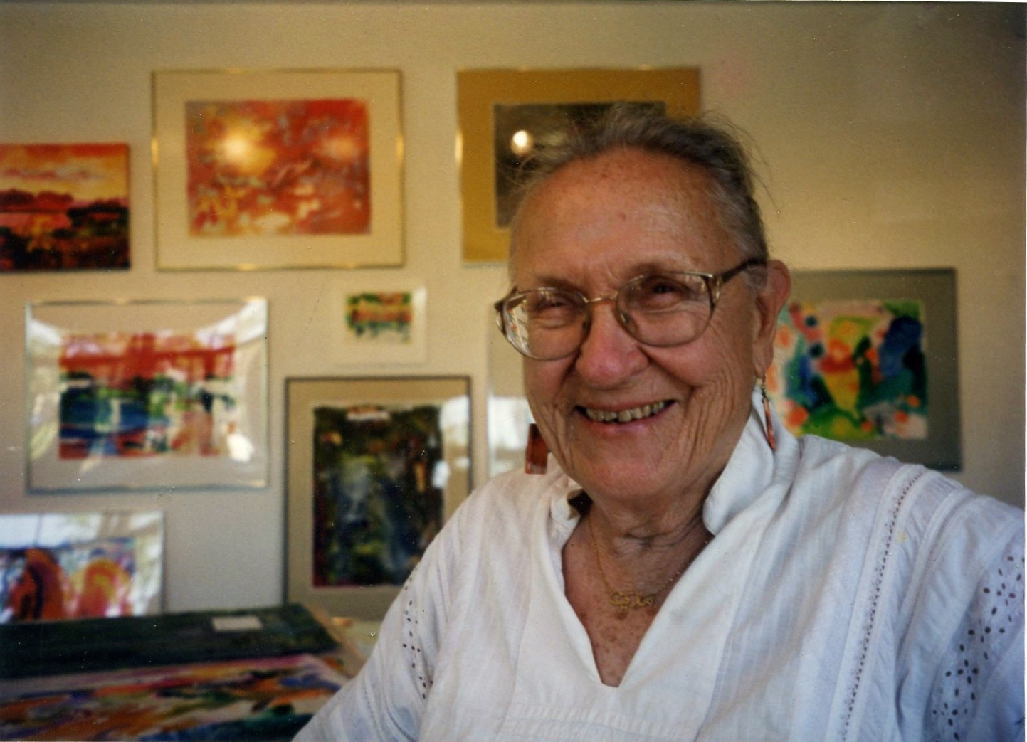
Notes:
Mary at Dot Brady’s gallery on North Krome Avenue in April of 1998.

Slide 50
The Art of Tom and Mary Blakley
mbceramics.iomaire.com

